Slide 1
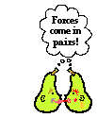
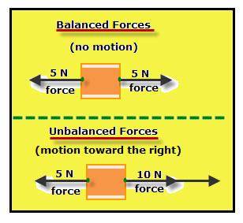
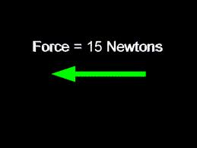
Forces

Slide 2
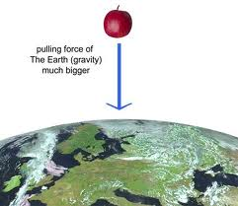
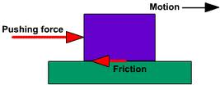
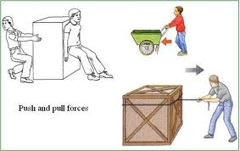
What is a force?
force is either a push or a pull
Example:

Slide 3
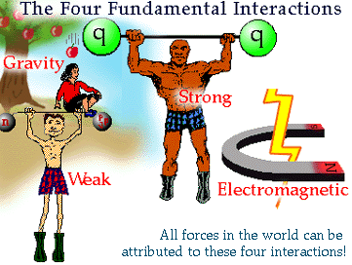
#2) There are four forces that hold all matter together
a) Strong nuclear force
b) Electromagnetic force
c) Weak force
d) Gravity.
EXAMPLE? an atom

Slide 4
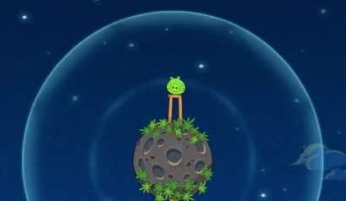
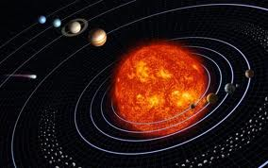
Different types of forces
3) Gravitational forces All objects in the universe are attracted to each other by gravity

Slide 5
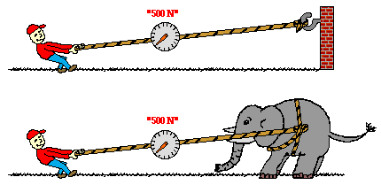
4) Tensional elastic force pulling apart

Slide 6
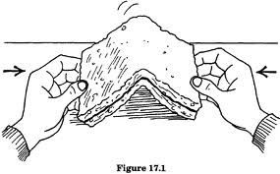
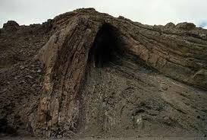
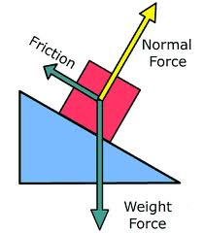
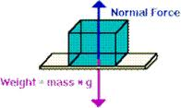
5) Compressional elastic force pushing together example: squeezing
6) Normal force – perpendicular
to surface
Example: rock climbers know this

Slide 7
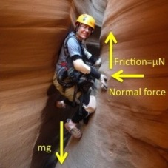
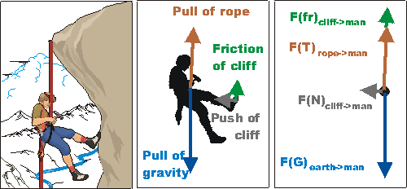
127 hours

Slide 8
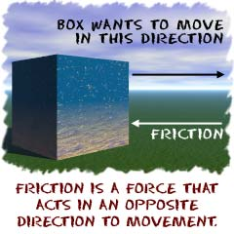
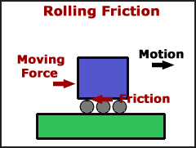
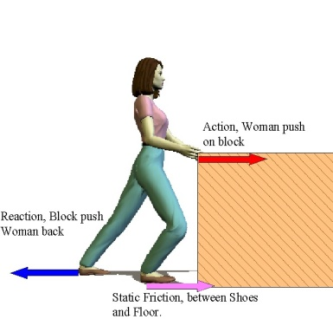
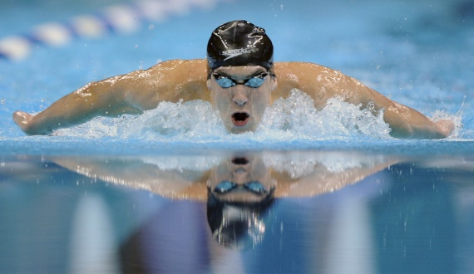
7 ) Friction – force exerted when two surfaces rub against each other (direction opposite to direction of movement)
ex: a) sliding
b) rolling
c) static
d) fluid

Slide 9
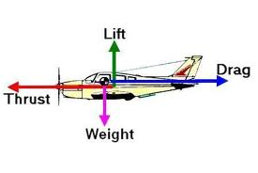
8) Forces used for Flight:
a) Thrust
b) Drag
c) Lift
d) Gravity
example = airplane flying

Slide 10
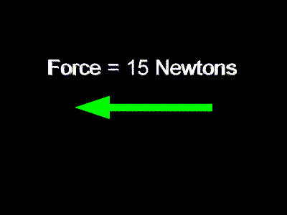
9) How are forces measured?
Forces are measured in newtons (N)
Forces are drawn as vectors. →
http://www.youtube.com/watch?v=A05n32Bl0aY&list=PL3E788EDA794CCE7B&index=16&feature=plpp_video

Slide 11
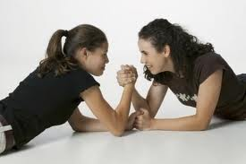
10) Balanced forces
Balanced forces – when all forces are equal, there is no change in motion.
Net force = 0
If it’s NOT moving it remains NOT moving.
If it is moving, then a balanced force won’t change the way its moving.

Slide 12
Balanced force while moving
3N
3N
2 m/s
If it is moving, then a balanced force won’t change the way its moving.
Ball moving to the right at 2 m/s
2 opposite forces are on the ball
Net force = 0 Newtons
So, motion remains unchanged

Slide 13
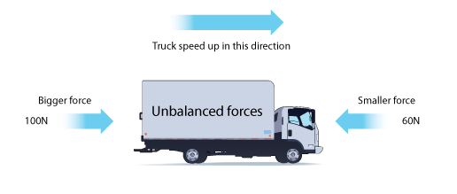
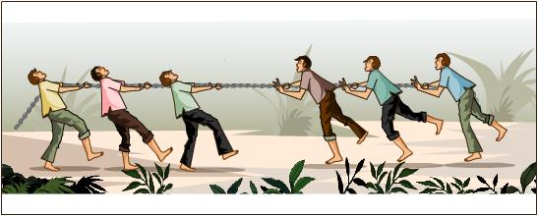
11) Unbalanced forces – when forces are unequal they will cause a change in motion.
If it is not moving, then an unbalanced force will cause it to move.
If it is moving, then it will cause the moving object to change is motion.

Slide 14
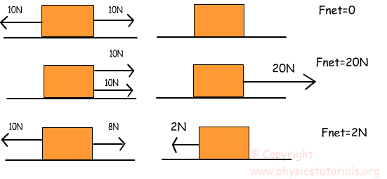
NET Force
12).Net force – is the total amount of forces all added up together.

Slide 15
13) Examples #1 - forces
10 N 10 N
Balanced or unbalanced? balanced
Direction of the movement? no movement
The net force is _______ 0 Net force
Is it compressional or tensional? compressional

Slide 16
14) Example #2 Answer the following questions according to your worksheet
3N 10 N
7 N tensional
4N + 10 N
14 N right

Slide 17
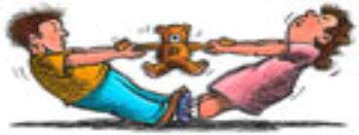
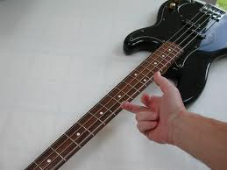
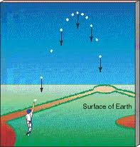
Which forces are present in theses pictures?

Slide 18
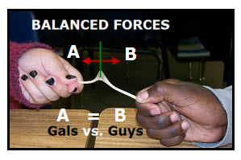
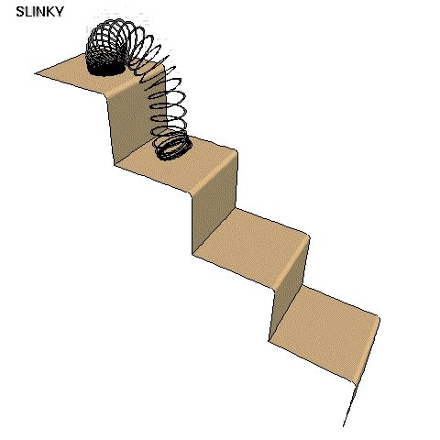
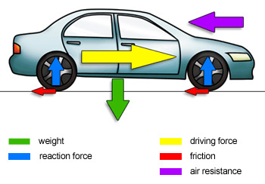

Slide 19
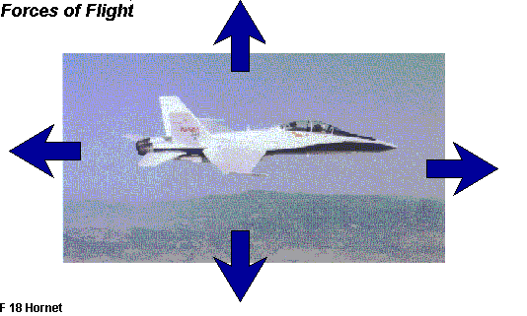
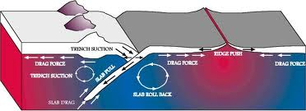
Can you guess the forces?

Slide 20
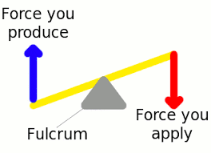
15) Fulcrum
The point on which a lever rests – and on which it pivots.

