Slide 1
SPACE RACE and U.S. Space Travels *only write the underlined parts
By Ms Toal

Slide 2
Animals in space – quick intro
1940’s – fruit flies
1950’s – first dog in orbit was LAIKA – from Russia – but it died.
57 dogs have been sent into space
1960 – France sent a rat and then a cat into space
The most famous is the monkey that traveled successfully back to earth

Slide 3
This is Laika – the famous Russian dog

Slide 4
The U.S. sent many monkeys to space. “Han” was the most successful of all the primates in space

Slide 5
Cats needed to be contained after they realized how their claws caused damage while in flight.

Slide 6
“HAN”

Slide 7
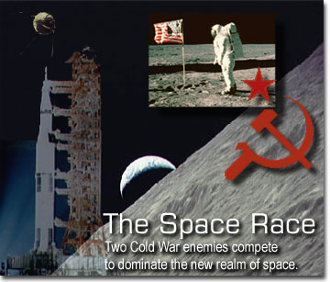
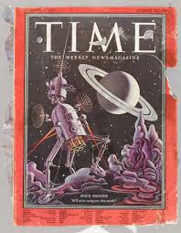
When did we start? (do not begin notes yet…)
In 1957, the “space race” began. Post WWII, the world was quite paranoid. Countries didn’t really trust one another. When “satellites” made the headlines, everyone thought the satellite was actually a bomb that was going to be dropped and end the world at any time. Very paranoid!
Both countries (US and Russia) wanted to win—to prove their scientific superiority and their military strength.

Slide 8
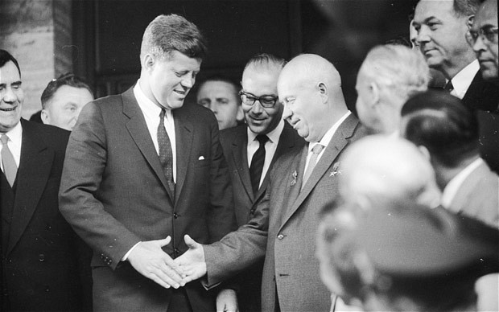
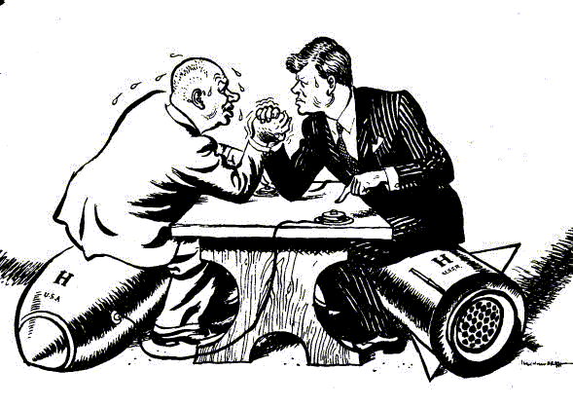
US and Soviet Leaders
Soviet Premier Khrushchev wanted to show that communist technology was superior.
President Kennedy wanted to beat the Soviets to the moon - speaking about sending astronauts to the moon.

Slide 9
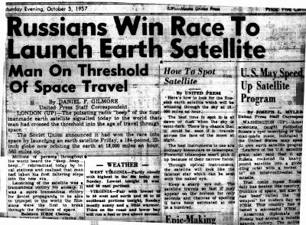
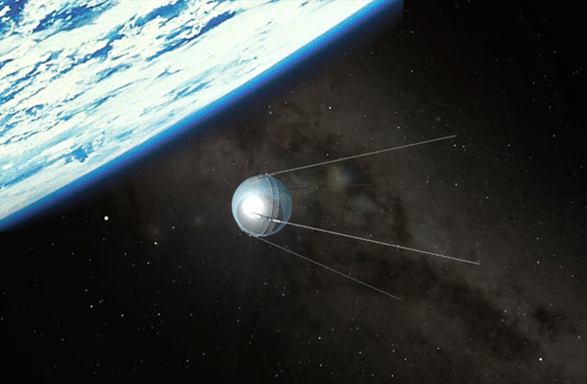
1957 (Begin taking notes, underlined only)
The Soviet Union launches Sputnik, the first artificial Earth satellite. "Sputnik" is the Russian word for "Traveler.”

Slide 10
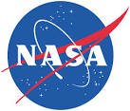
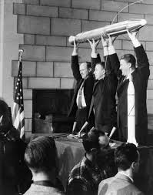
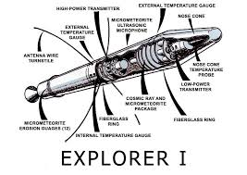
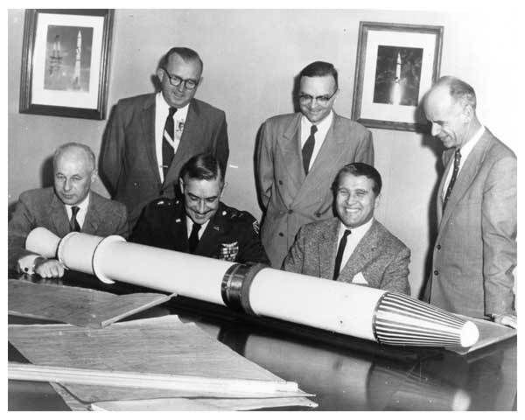
1958
The United States launches its first satellite, Explorer I.
The National Aeronautics and Space Administration (NASA) is formed in the United States. NASA is the federal agency devoted to exploring space.

Slide 11
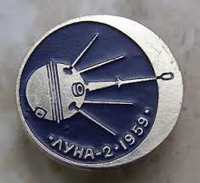
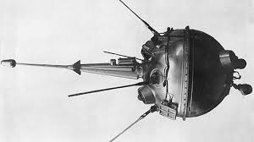
1959
The Soviet Union launches Luna 2. This is the first space probe to hit the moon.

Slide 12
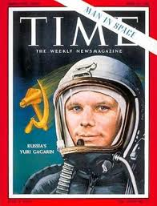
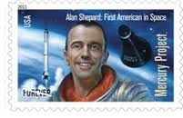
1961
Soviet cosmonaut Yuri Gagarin becomes the first person to orbit the Earth. (April 12, 1961)
Alan Shepard, Jr. becomes the first (American) astronaut in space. (May 5, 1961)

Slide 13
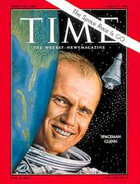
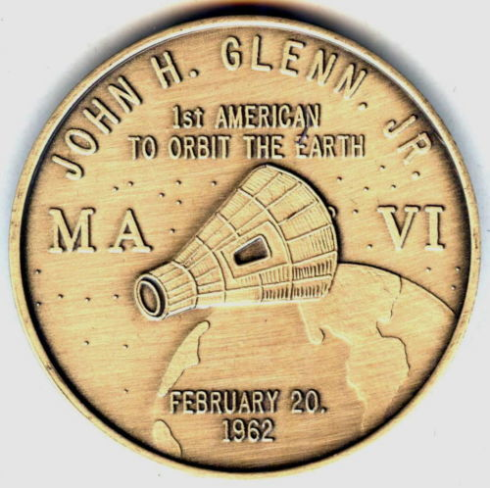
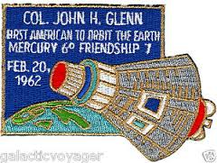
1962
John Glenn, Jr. becomes the first American astronaut to orbit the Earth.

Slide 14
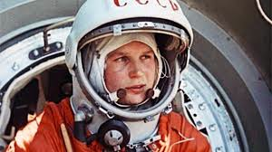
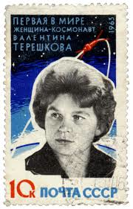
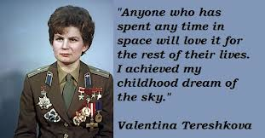
1963
The first woman in space is Soviet cosmonaut Valentina Tereshkova.

Slide 15
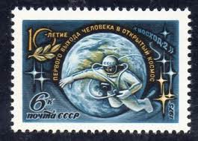
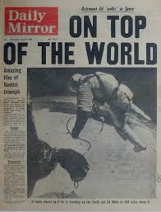
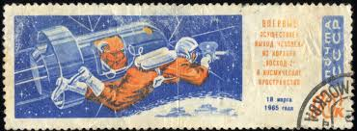
1965
A Russian cosmonaut completed the first space walk.

Slide 16
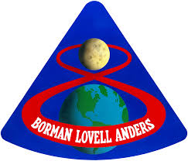
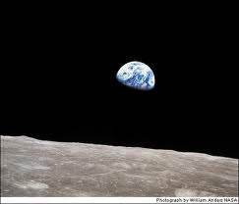
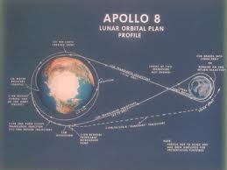
1968
The United States launches Apollo 8, the first manned space mission to orbit the moon.

Slide 17
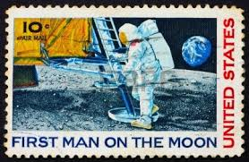
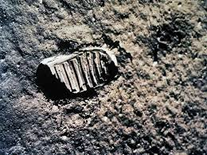
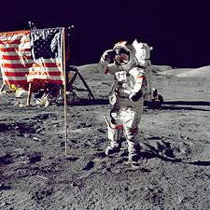
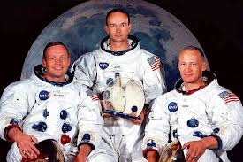
1969
US = 1st man on the moon☺
U.S. astronauts Neil Armstrong, Edwin "Buzz" Aldrin and Michael Collins make it to the moon. Armstrong is the first man to walk on the moon and was followed by Buzz Aldrin. On the moon video
lift off and landing

Slide 18
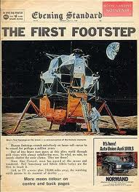
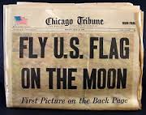
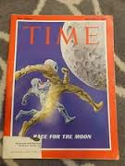
Who won?
By reaching the moon first, the United States won the space race. Soviet and U.S. leaders knew that being the first country to land on the moon would be an extremely important media event. The world watched each country’s progress with great interest.

Slide 19
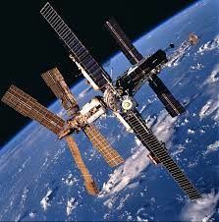
1971
The first space station, Salyut 1, was sent into orbit
MIR was launched by USSR

Slide 20
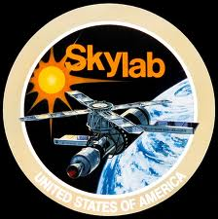
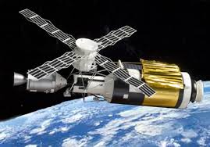
1973
US launches Skylab

Slide 21
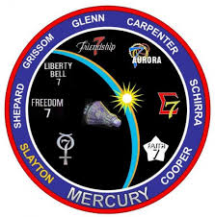
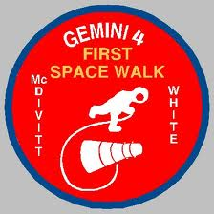
Missions
Project Mercury - To orbit a manned spacecraft around Earth
Project Gemini – send 2 men and equipment to space flight up to two weeks in duration and to perfect methods of entering the atmosphere and landing

Slide 22
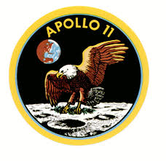
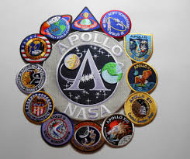
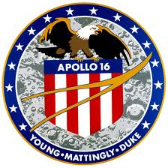
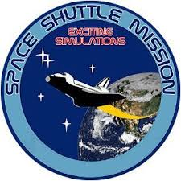
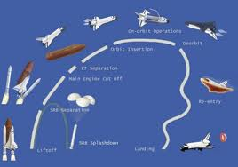
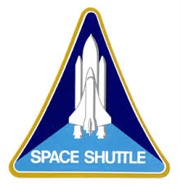
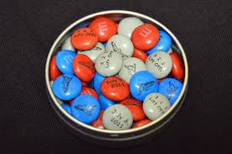
Other Missions
Apollo Missions - to carry out a program of scientific exploration of the Moon.
Space Shuttles – to work with other countries on the ISS and be able to bring back shuttles and re-use them for more launches.

Slide 23
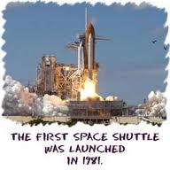
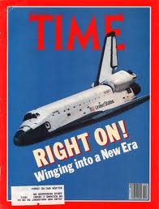
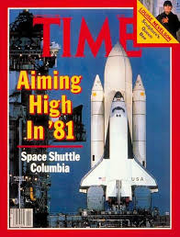
Space shuttle
First launch of space shuttle = 1981

Slide 24
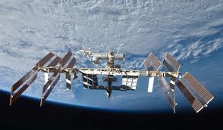
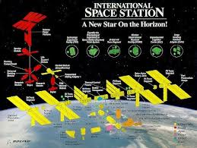
ISS
Orbits 250 miles up from Earth.
Scientific research for 16 nations
last shuttle to LA
fly over planet earth

Slide 25
Fly to edge of space
Mig -25 99.9% of atmosphere 20,000 m and higher
F-104
The SR-71 flies in excess of 85,000 feet (16 miles up). The curvature of the Earth has been said to be visible.

Slide 26
Costs
In 2005 the space shuttle program’s cost was $145 billion.
The predicted cost in 2010 is $175 billion.
The average cost per launch WAS $1.3 billion.

Slide 27
5 Shuttles
Columbia – lost during re-entry 2003
Challenger – lost 73 sec after liftoff 1986
Atlantis – Kennedy Space Center
Discover - Smithsonian National Air and Space Museum in Virginia.
Endeavor - Samuel Oschin Air and Space Center

Slide 28
Challenger Disaster
Lost 73 seconds after liftoff on Jan 26, 1986
Due to a frozen O-ring
Everyone was watching the lift off on TV and it totally blew up after one minute of launch.
One astronaut was a female middle school social studies teacher

Slide 31
Columbia Disater
Began disintegrated during re-entry on Feb. 1, 2003 over California, Texas, and rained debris as far as Louisiana.
It had a weakness in the heat shield so when they re-entered the atmosphere, the heat and friction caused it to burn up in our atmosphere.

