Slide 1
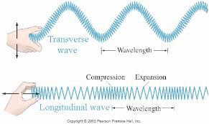
W A V E S
Write what is in WHITE. You will do this as an outline format

Slide 2
1. Wave
a disturbance that transfers energy from one place to another.
Duck Example
2. Medium
any substance that a wave moves through
Examples: can be a solid liquid or gas
Can you hear sound in space?
Sound in space

Slide 3
3. Mechanical Waves-
waves that require a medium
Ex: Sound
4. Electromagnetic Waves-
waves that do not require a medium
Ex: visible light, radio waves

Slide 4
5. Longitudinal Wave
wave particles vibrate back and forth along the path that the wave travels.
Also known as a : Compressional Wave
5a. Compressions
The close-together part of the wave
5b. Rarefactions
The spread-out parts of a wave

Slide 5
Longitinal Waves (cont.)
Ouch!
C = Compression (high kid density)
R = Rarefaction (low kid density)
The compression (the pulse) moves up the line, but each kid keeps his place in line.
C
Ouch!
R
C
Ouch!
I hope Godzilla eats that bully!
R
C

Slide 6
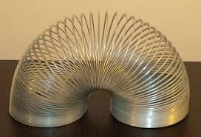
6. Transverse waves
wave particles vibrate in an up-and-down or side-to-side motion

Slide 7
7. Wavelength- the distance between two successive points in the wave. (measured in meters)
8. Crests- Highest part of a wave
9. Troughs- The low points of the wave
10. Amplitude- is the maximum distance in a wave from its rest position. (height- in meters)

Slide 8
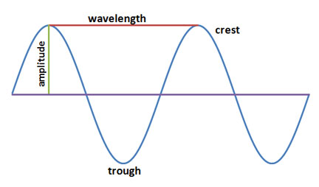
Draw and include labels when shown

Slide 9
https://www.youtube.com/watch?v=jmYemuXCC6Y
https://www.youtube.com/watch?v=X1OGiWPq5j8

Slide 10
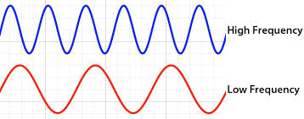
11. Frequency- the number of waves produced in a given time
a) Unit= measured in Hertz, Hz

Slide 11
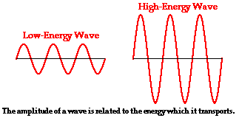
12. E α A²- Energy is proportional to amplitude squared
Tacoma narrow bridge
https://www.youtube.com/watch?v=3mclp9QmCGs
https://www.youtube.com/watch?v=nFzu6CNtqec

Slide 12
13. Photon- A massless “no rest” particle (that’s why it travels so fast – has no mass)
Travels 186,282 miles per second (Speed of light)

Slide 13
You tube waves
https://www.youtube.com/watch?v=1M8ciWSgc_k
https://www.youtube.com/watch?v=yVkdfJ9PkRQ
https://www.youtube.com/watch?v=iqpV1236_Q0&t=151s
https://www.youtube.com/watch?v=pk1y_qIAQ-w

Slide 14
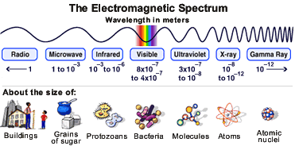

Slide 15
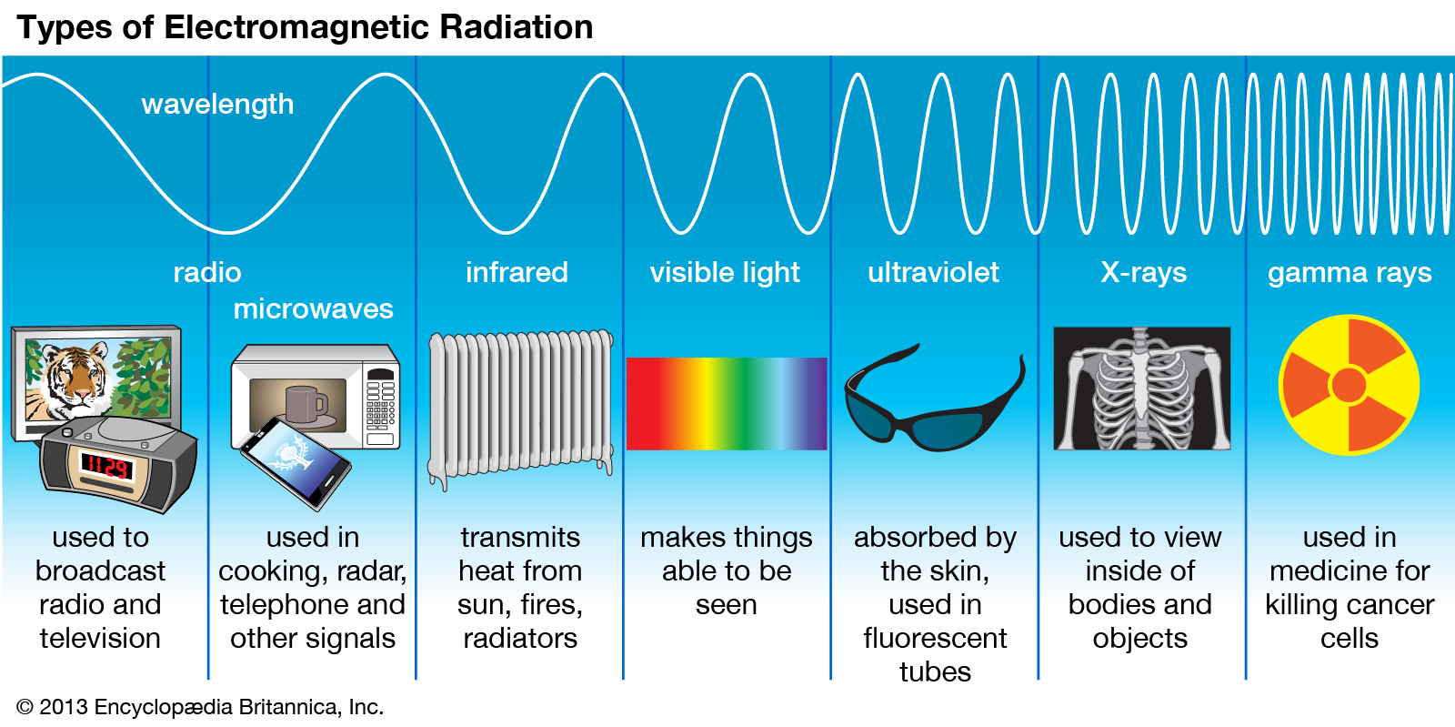
http://www.pbslearningmedia.org/resource/nvsl.sci.space.spectrum/the-electromagnetic-spectrum/

Slide 16
EM Spectrum
Radio Waves
Infrared
Visible Light
Ultra Violet
Xrays
Gamma Rays
Low end of spectrum, mile long wavelength, low frequency
Heat rays, used to determine temperature of stars
3% of light, red → violet
Causes chemical change (sunburn)
Shorter wavelength/higher frequency than UV, depends on voltage
Highest frequency/shortest wavelength
Most dangerous, found in universe

