Slide 1
Triple Beam Balance and Graduated Cylinder

Slide 2
A. Triple beam balance
Used to measure MASS

Slide 3
Pan
Base

Slide 4
B. How to use
1. Pan needs to be empty
2. All riders are all the way to the left
3. Check if pointer is at zero mark
If not- Turn adjustment knob slightly
Too much will BREAK IT

Slide 5
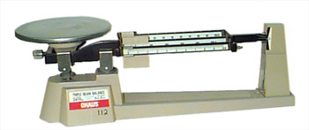
4. Place object on pan
5. Move 100 g rider first by notches until pointer dips below zero mark
6. Move 100 g rider BACK one notch
7. Now move the 10 g rider
8. Lastly move the 1 g rider until pointer is at zero
OBJECT

Slide 6
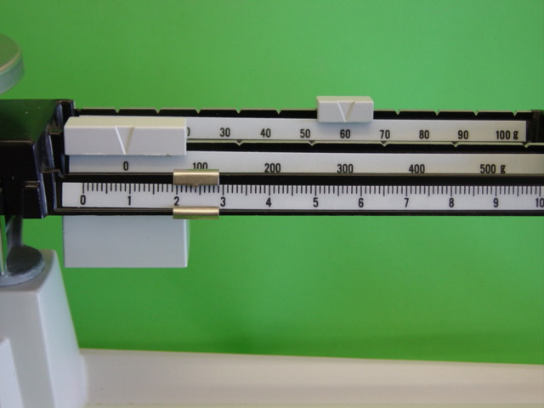
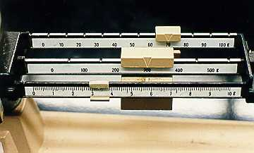
c. Record mass
Add the numbers on the three riders
100 g rider= 0 g
10g rider= 60 g
1g rider= 2.4 g
300
70
0 + 60 + 2.4= 62.4
300 + 70 + 3.4= 373.4 g
3.4

Slide 7
http://www.ohaus.com/input/tutorials/tbb/TBBread.html
https://www.explorelearning.com/index.cfm?method=cResource.dspDetail&ResourceID=385

Slide 8
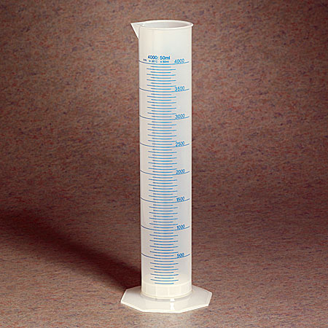
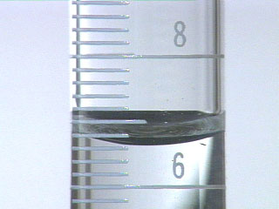
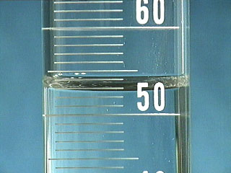
D. Graduated Cylinder
Used to measure VOLUME
Read the meniscus
Bottom of curve
At eye level
7.8 7.6 7.4 7.2 7.0 6.8 6.6 6.4 6.2
7
52mL
6.6mL

