Slide 1
Carbon
For this PowerPoint, in your notes only write what is GREEN

Slide 2
Carbon
Is the 6th most common element on Earth.
94% of the 6 million known compounds contain carbon.
Carbon has a central role in the chemistry of living things
Carbon, in the form of diamond, is the hardest mineral on Earth.
Compounds of carbon are coal, natural gas and oil.

Slide 3
Carbon alone (pure)
Forms graphite and diamond.
Graphite is soft and slippery
Diamond is the hardest natural substance known to man
The difference is the way carbon bonds with each other.

Slide 4
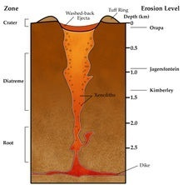
Diamonds…
Pure carbon
Diamond have atoms so tightly bonded together that they are the hardest substance known.
Very high pressure and temperature is needed to form diamond from carbon atoms

Slide 5
Graphite
Pure carbon
Black, soft, harder than coal, but way softer than diamond.
Graphite is carbon in sheets.
These sheets can be reshaped to make new shapes and this idea is big in nanotechnology

Slide 6
Electrons
Has four valence electrons
Since the energy shell can hold 8 electrons, each carbon atom can share electrons with up to four different atoms.
Can make 4 bonds
Carbon can combine with other elements and itself.
Forms many different compounds of different sizes and shapes.

Slide 7
Carbon bonding
Very strong covalent bonds between carbon atoms in each layer
But only weak forces exist between layers.
Can make: single bonds double bonds triple bonds

Slide 8
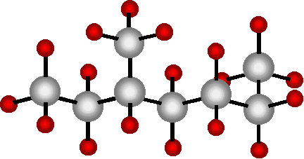
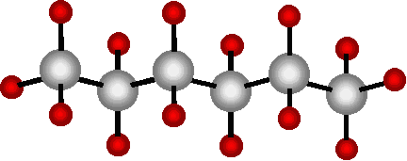
More ways carbon can be arranged:
Straight chains
Branch chains

Slide 9
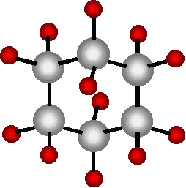
More . . . .
Rings – a portion of a buckyball

Slide 10
Buckyballs
Basically when you take carbon filaments and roll them up into ball – like a geodesic dome, you get an incredibly strong and lightweight material used in space technology, sports equipment…

Slide 11
Carbon filaments
So, graphite is carbon as one plane.
Take carbon and roll it into nanotubes or buckyballs.
New ideas in chemistry since 1991

Slide 12
Why is carbon so special?
Because it can form so many compounds.
It can form strong links with four other atoms.
It can link in chains, making polymer chains. These links are chemical bonds.
These links cannot be broken by water, air, or bacteria.
These items stay in our landfills for a long time.

