Slide 1
Experimental Design
This concept will be integrated throughout the year – refer to these notes when needed
(**Write just the underlined parts)

Slide 2
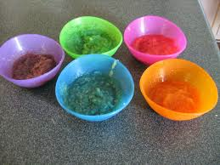
HYPOTHESIS
Ex: #1
Ex #2:
your prediction before you change a variable
IF __(IV)___, THEN __(DV)__.
If I add food coloring to the applesauce, then my students will choose… the colored applesauce over the regular applesauce.
If a paper clip is added to the nose of the plane, then it will fly farther. (or increasing the weight of the nose.

Slide 3
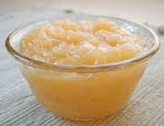
an unchanged parto fo the experiment (used in to detect the effects of hidden variables.
regular applesauce
the original plane you fly without paperclips.
Control
Ex:#1
Ex #2:

Slide 4
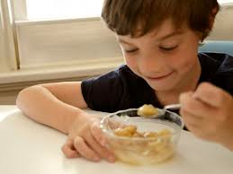
Trial:
Ex:#1
Ex #2:
each time you do an experiment; each time you collect data.
each one of my students, 32 trials.
each time you throw the plane.

Slide 5
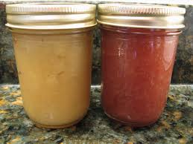
a variable is purposely changed in an experiment.
the color.
the number of paper clips.
Independent Variable:
Ex:#1
Ex #2

Slide 6
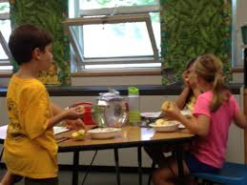
Dependent Variable:
Ex:#1
Ex #2
The thing you “meausure” because of the independent variable.
the “frequency” of the color that is chosen.
the distance.

Slide 7
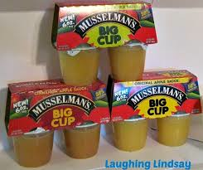
all the factors that remain the same through out the experiment.
the type/amount of applesauce, the cup, portion, temperature…
the paper, size of paper clip, wind, throw, environmental conditions.
Constant
Ex:#1
Ex #2

Slide 8
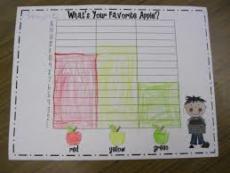
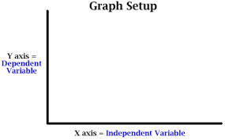
Data Table
independent variable on the x-axis,
dependent variable on the y-axis.

Slide 9
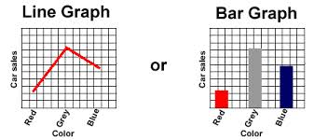
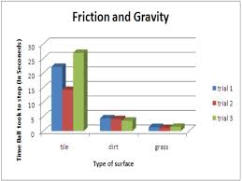
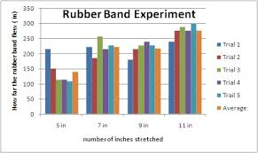
What type of graph?????
The graph may look something like this-. Line and bar graph. Which one is correct? The bar graph is correct because the IV is non-numerical.

