Slide 1
Heredity Vocabulary

Slide 2
Pencils down, you will not write the next few slides

Slide 3
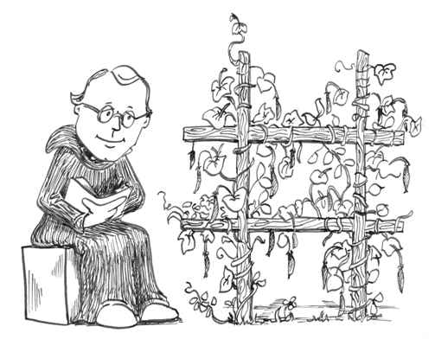
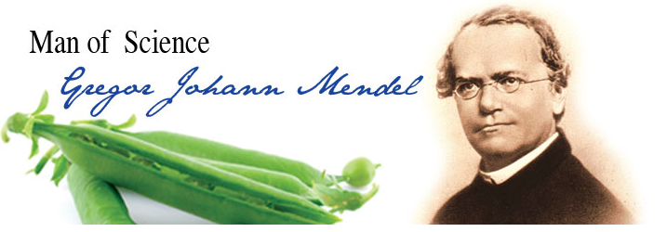
Who is Gregor Mendel?
Principle of Independent Assortment – Inheritance of one trait has no effect on the inheritance of another trait
“Father of Genetics”

Slide 4
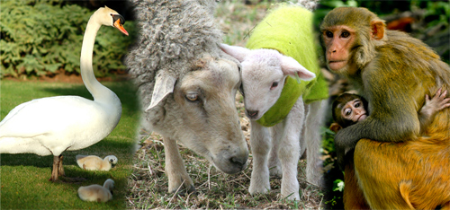
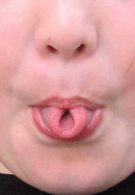
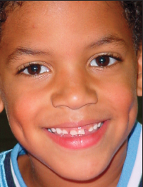
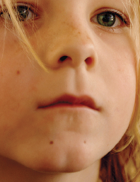
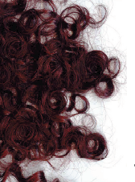
Genetics – study of how traits are passed from parent to offspring

Slide 5
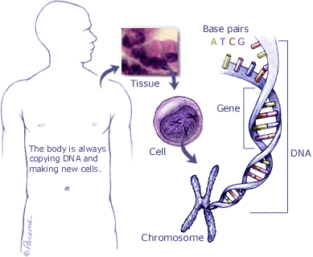
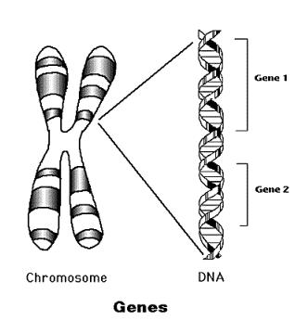
Traits are determined by the genes on the chromosomes. A gene is a segment of DNA that determines a trait.

Slide 6
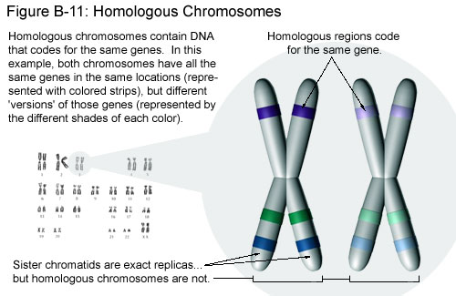
Chromosomes come in homologous pairs, thus genes come in pairs.
Homologous pairs – matching genes – one from female parent and one from male parent
Ex: Humans have 46 chromosomes or 23 pairs.
One set from dad – 23 in sperm
One set from mom – 23 in egg

Slide 8

One pair of Homologous Chromosomes:
Gene for eye color (blue eyes)
Homologous pair of chromosomes
Gene for eye color (brown eyes)
Alleles – different genes (possibilities) for the same trait –
ex: blue eyes or brown eyes

Slide 9
Start Writing

Slide 10
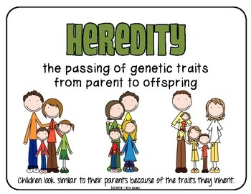
1. Heredity
Passing of traits from parents to offspring
Heredity

Slide 11
2. Genetics
Is the study of how traits are inherited.
http://learn.genetics.utah.edu/content/basics/traits/

Slide 12
3.Dominant Trait
Dominant= upper case letter, T
The trait from the parent that is observed or “shows”

Slide 13
4. Recessive Trait
“masked”
The trait that may not “show”
Even though it is present, It is “masked”
Recessive= lower case letter, t

Slide 14
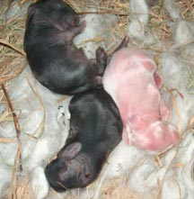
Dominant and Recessive Genes
Gene that prevents the other gene from “showing” – dominant
Gene that does NOT “show” even though it is present – recessive
Symbol – Dominant gene – upper case letter – T
Recessive gene – lower case letter – t
Recessive color
Dominant color

Slide 15
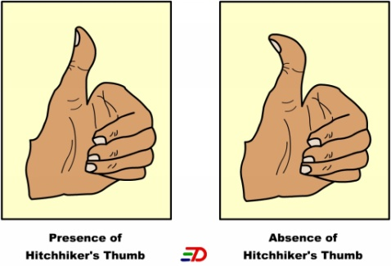
Ex: Straight thumb is dominant
to hitchhiker thumb
T = straight thumb t = hitchhikers thumb
(Always use the same letter for the same alleles—
No S = straight, h = hitchhiker’s)
Straight thumb = TT
Straight thumb = Tt
Hitchhikers thumb = tt
* Must have 2 recessive alleles for a recessive trait to “show”

Slide 16
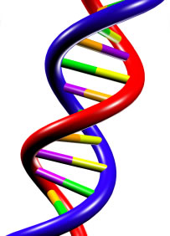
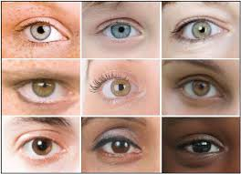
5.Genes
One set of instructions for an inherited trait
  Example=- Part of DNA
http://learn.genetics.utah.edu/content/basics/dna
6.Alleles
The different version of a gene
Example- eye color= TRAIT
brown, blue or green eyes= ALLELES

Slide 17
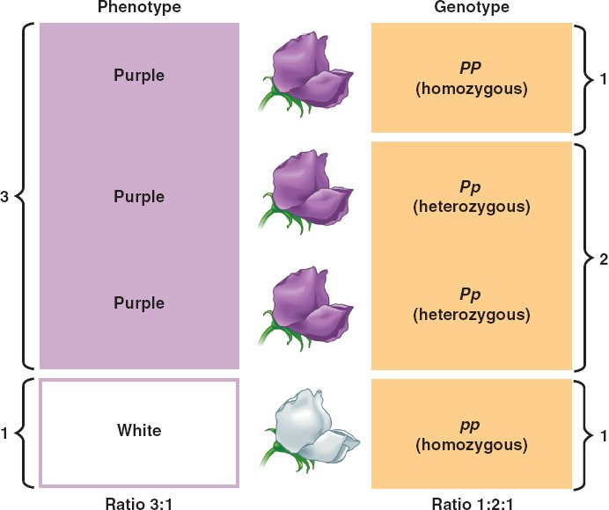
7. Phenotype
An organism’s appearance
EX:Color of flower

Slide 18
8. Genotype
The genetic makeup of an organism
It is represented by two letters

Slide 19
9. Homozygous or Purebred
HH=
homozygous
dominant
hh-
homozygous
recessive
When an organism has TWO of the SAME allele

Slide 20
10. Heterozygous or Hybrid
Having ONE each of the POSSIBLE alleles
Hh

Slide 21
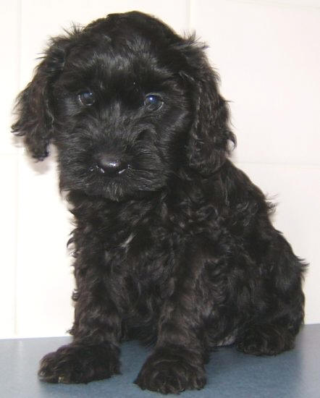
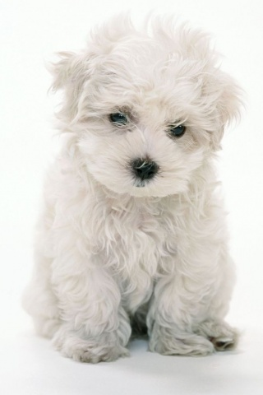
Which genotype is heterozygous?
BB – Black
Bb – Black
w/
white
gene
bb – White

Slide 22
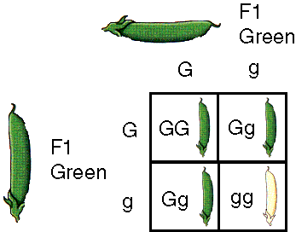
What is the dominant PHENOTYPE?
What is the recessive PHENOTYPE?
GREEN
WHITE

Slide 23
11. Punnett Square
Used to predict the possible gene makeup of offspring
https://www.youtube.com/watch?v=9ie3lbxTAcY&list=PLzxOJSa84KzfnYbmvMk5T2gLJKLAOBwX2&index=2
https://www.youtube.com/watch?v=9ie3lbxTAcY&list=PLzxOJSa84KzfnYbmvMk5T2gLJKLAOBwX2&index=2

Slide 24
Ratios
Write the ratios in the following orders:
Genotypic ratio:
Homozygous dominant: Heterozygous: Homozygous recessive
Phenotypic ratio:
Dominant: Recessive

Slide 25
12.Probability
the chance that something will happen

Slide 26
Male = Bb X Female = bb
Female gametes – N
(One gene in egg)
b
b
Bb | Bb
bb | bb
Possible offspring – 2N
B
Male gametes - N
(One gene in sperm)
b
Genotypic ratio = 2 Bb : 2 bb
50% Bb : 50% bb
Phenotypic ratio = 2 black : 2 white
50% black : 50% white

Slide 27
Cross 2 hybrid mice and give the genotypic ratio and phenotypic ratio.
Bb X Bb
B
b
BB | Bb
Bb | bb
B
b
Genotypic ratio = 1 BB : 2 Bb : 1 bb
25% BB : 50% Bb : 25% bb
Phenotypic ratio = 3 black : 1 white
75% black : 25% white

Slide 28
Example: A man and woman, both with brown eyes (B) marry and have a blue eyed (b) child. What are the genotypes of the man, woman and child?
Bb X Bb
Man = Bb
Woman = Bb
B
b
BB | Bb
Bb | bb
B
b

Slide 29
Crossing involving 2 traits – Dihybrid crosses
Example: In rabbits black coat (B) is dominant over brown (b) and straight hair (H) is dominant to curly (h). Cross 2 hybrid rabbits and give the phenotypic ratio for the first generation of offspring.
Possible gametes:
BbHh X BbHh
BH BH
Bh Bh
bH bH
bh bh
Gametes
BH
Bh
bH
bh
BBHH | BBHh | BbHH | BbHh
BBHh | BBhh | BbHh | Bbhh
BbHH | BbHh | bbHH | bbHh
BbHh | Bbhh | bbHh | bbhh
BH
Phenotypes - 9:3:3:1
Bh
9 black and straight
3 black and curly
bH
3 brown and straight
1 brown and curly
bh

Slide 30
Example: In rabbits black coat (B) is dominant over brown (b) and straight hair (H) is dominant to curly (h). Cross a rabbit that is homozygous dominant for both traits with a rabbit that is homozygous dominant for black coat and heterozygous for straight hair. Then give the phenotypic ratio for the first generation of offspring.
BBHH X BBHh
Possible gametes: BH BH
Bh
BH
Bh
Gametes
Phenotypes:
BBHH | BBHh
BH
100% black and straight
Gametes
(Hint: Only design Punnett squares to suit the number of possible gametes.)

Slide 31
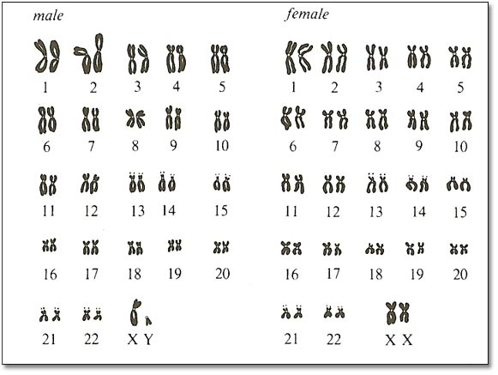
Sex Determination
People – 46 chromosomes or 23 pairs
22 pairs are homologous (look alike) – called autosomes – determine body traits
1 pair is the sex chromosomes – determines sex (male or female)
Females – sex chromosomes are homologous (look alike) – label XX
Males – sex chromosomes are different – label XY

Slide 32
What is the probability of a couple having a boy? Or a girl?
Chance of having female baby? 50%
male baby? 50%
X
X
XX | XX
XY | XY
X
Y
Who determines the sex of the child? father

Slide 33
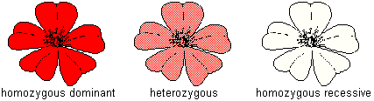
Incomplete dominance and Codominance
When one allele is NOT completely dominant over another (they blend) – incomplete dominance
Example: In carnations the color red (R) is incompletely dominant over white (W). The hybrid color is
pink. Give the genotypic and phenotypic ratio from a cross between 2 pink flowers.
RW X RW
R
W
R
RR | RW
RW | WW
W
Genotypic = 1 RR : 2 RW : 1 WW
Phenotypic = 1 red : 2 pink : 1 white

Slide 34
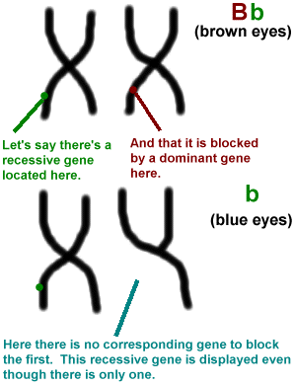
Sex – linked Traits
Genes for these traits are located only on the X chromosome (NOT on the Y chromosome)
X linked alleles always show up in males whether dominant or recessive because males have only one X chromosome

Slide 35
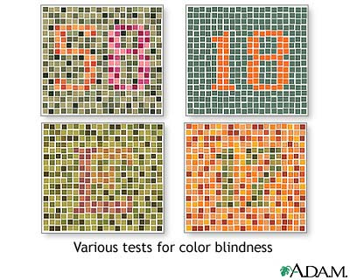
Examples of recessive sex-linked disorders:
colorblindness – inability to distinguish between certain colors
You should see 58 (upper left), 18 (upper right), E (lower left) and 17 (lower right).
Color blindness is the inability to distinguish the differences between certain colors. The most common type is red-green color blindness, where red and green are seen as the same color.

Slide 36
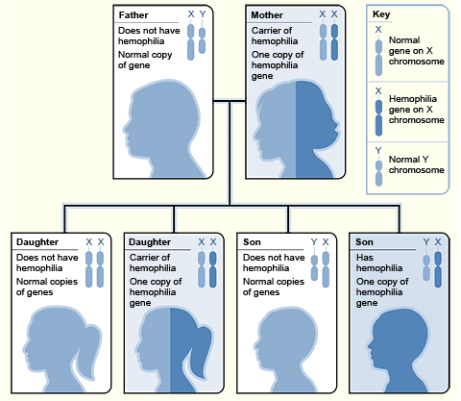
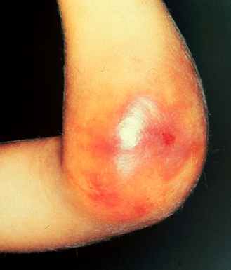
2. hemophilia – blood won’t clot

Slide 37
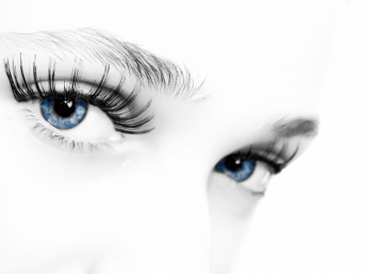
Example: A female that has normal vision but is a carrier for colorblindness marries a male with normal vision. Give the expected phenotypes of their children.
N = normal vision
n = colorblindness X^{N} X^{n} X X^{N} Y
X^{N}
X^{n}
X^{N}X^{N} | X^{N}X^{n}
X^{N}Y | X^{n}Y
X^{N}
Y
Phenotype: 2 normal vision females
1 normal vision male
1 colorblind male

Slide 38
FROM the green book, THE NEXT 3 SLIDES ARE PAGES FROM TEXTBOOK.
For number 13 (1 gene, many traits), 14 (Many genes, 1 trait), 15 (importance of environment), 16 (Genetic Variation)
Write a 1-2 sentence summary. For the example, write or draw one example from the reading
http://learn.genetics.utah.edu/content/basics/inheritance/

Slide 39
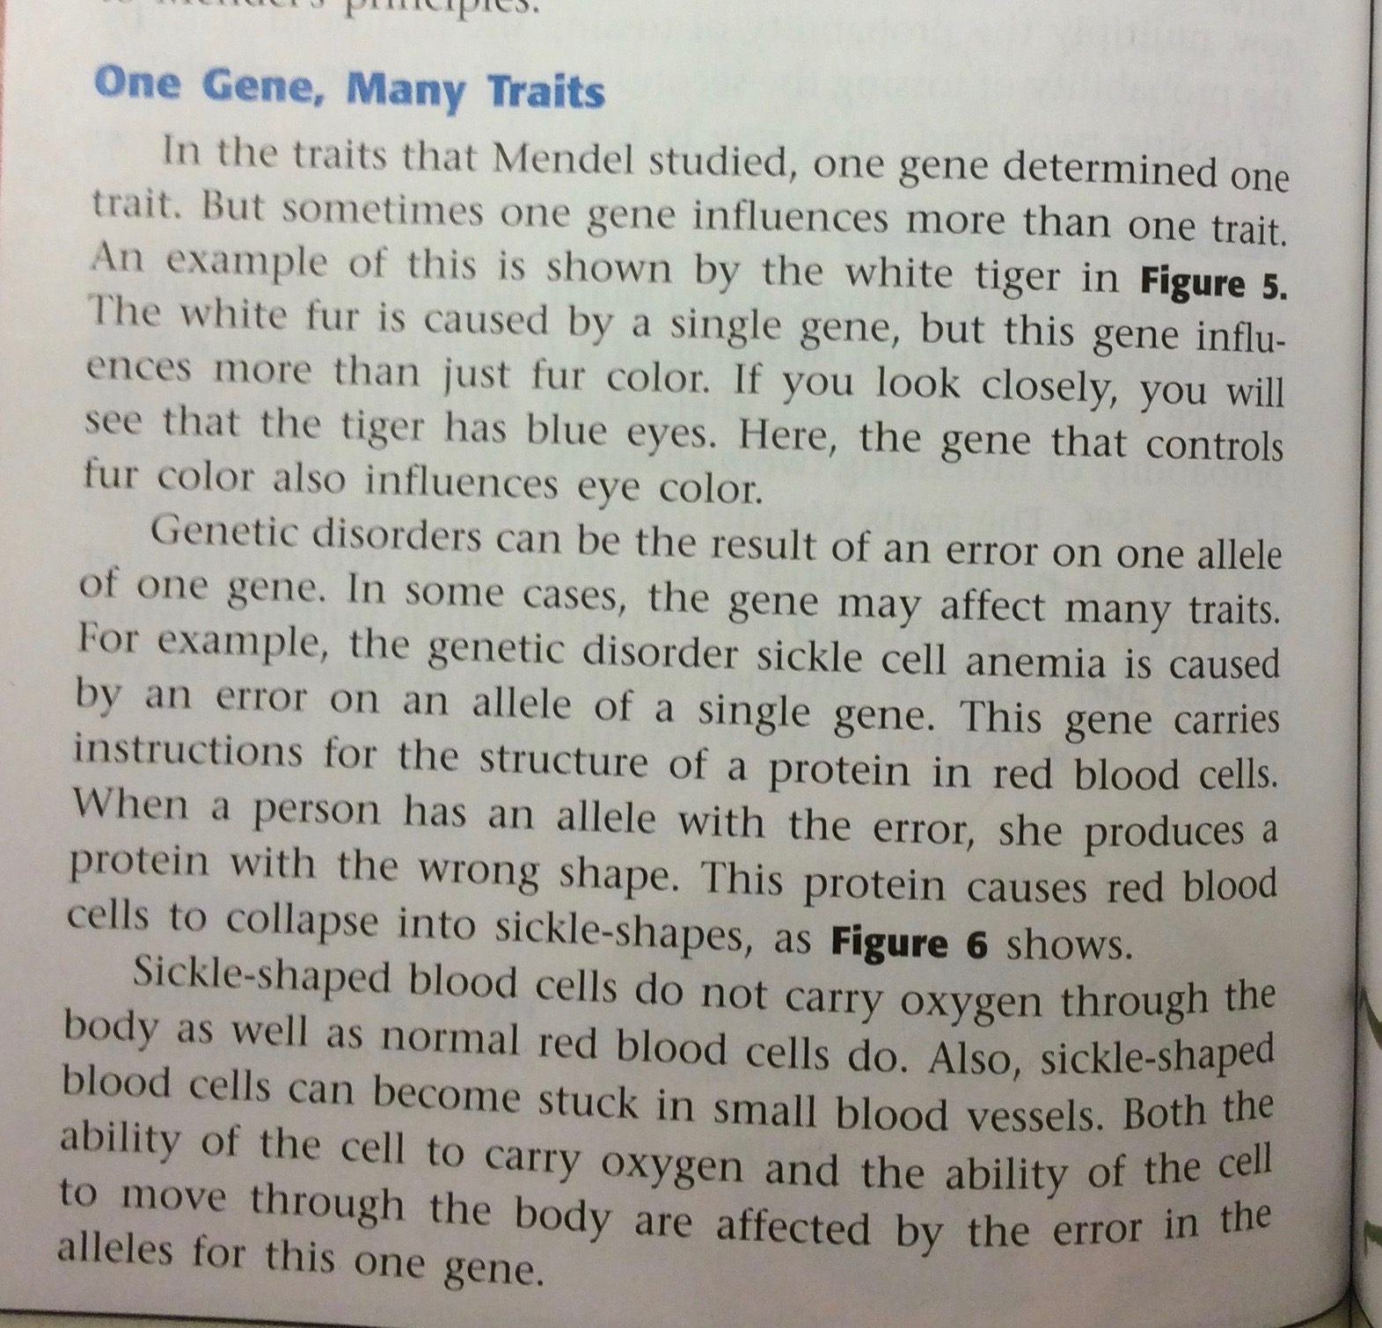

Slide 40
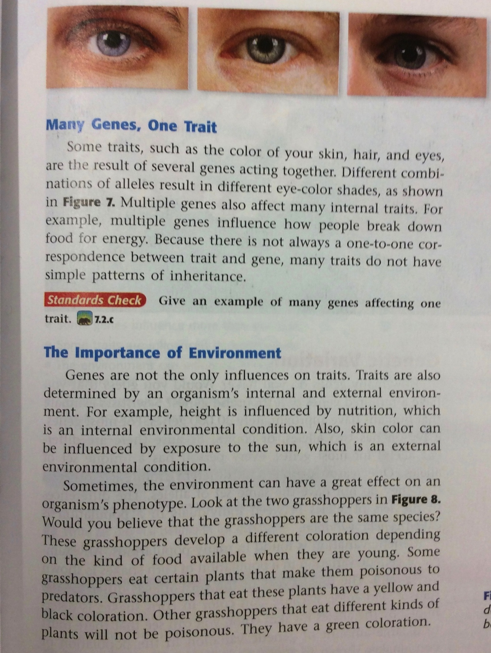

Slide 41
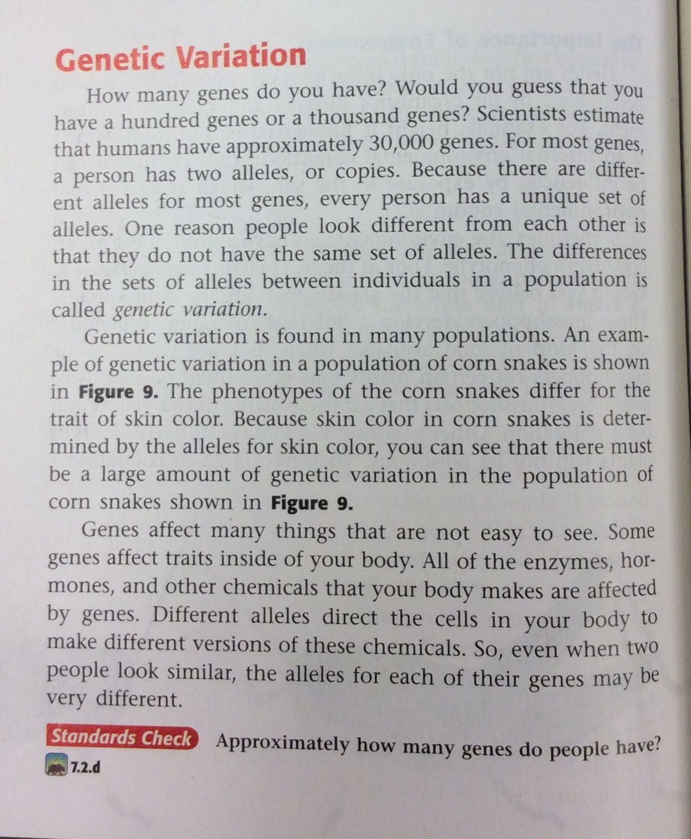

Slide 42
17. MUTATIONS
Structural change to DNA
May affect proteins
May result in
HARMFUL, BENEFICIAL or NEUTRAL effects
http://learn.genetics.utah.edu/content/basics/mutation/

Slide 43
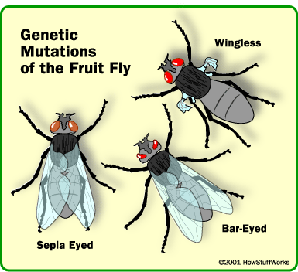
Mutations
Mutation – sudden genetic change (change in base pair sequence of DNA)
Can be :
Harmful mutations – organism less able to survive: genetic disorders, cancer, death
Beneficial mutations – allows organism to better survive: provides genetic variation
Neutral mutations – neither harmful nor helpful to organism
Mutations can occur in 2 ways: chromosomal mutation or gene/point mutation

Slide 44
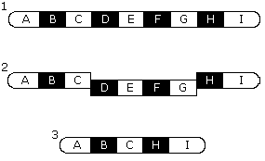
Chromosomal mutation:
less common than a gene mutation
more drastic – affects entire chromosome, so affects many genes rather than just one
caused by failure of the homologous chromosomes to separate normally during meiosis
chromosome pairs no longer look the same – too few or too many genes, different shape

Slide 45
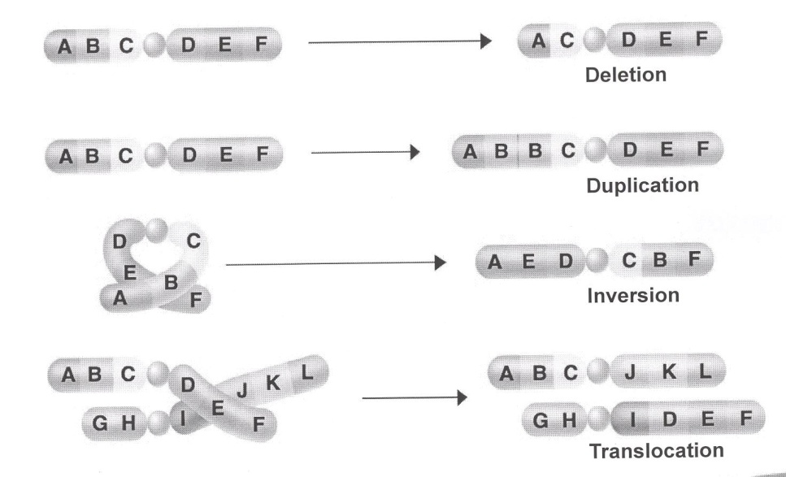

Slide 46
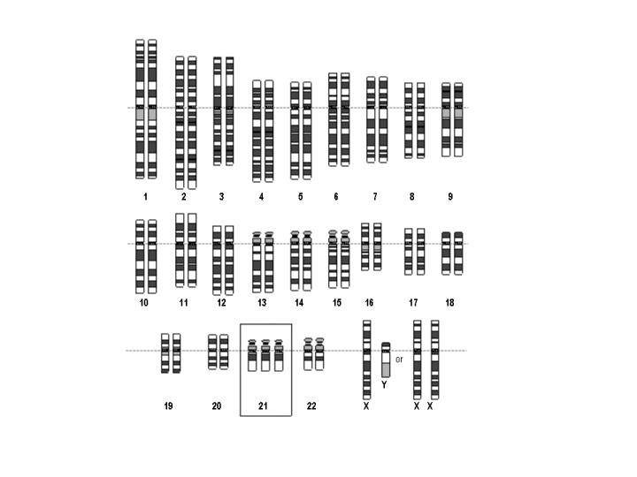
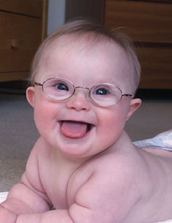
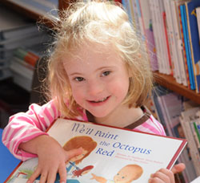


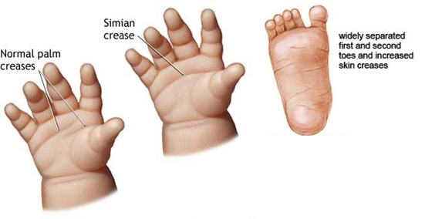
Examples:
Down’s syndrome – (Trisomy 21) 47 chromosomes, extra chromosome at pair #21

Slide 47
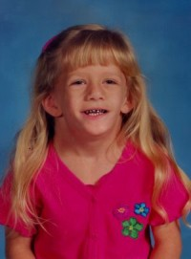
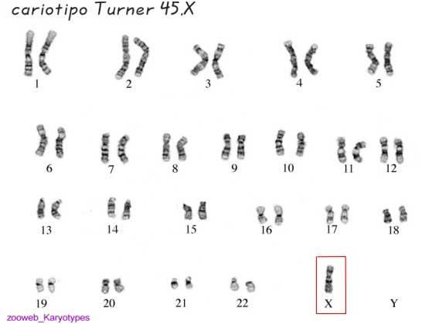
Turner’s syndrome – only 45 chromosomes, missing a sex chromosome (X)
Girls affected – short, slow growth, heart problems

Slide 48
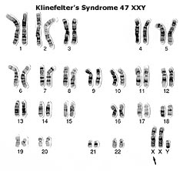
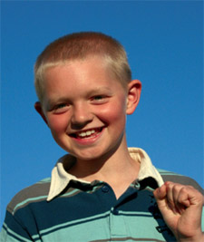

Klinefelter’s syndrome – 47 chromosomes, extra X chromosomes (XXY)
Boys affected – low testosterone levels, underdeveloped muscles, sparse facial hair

Slide 49
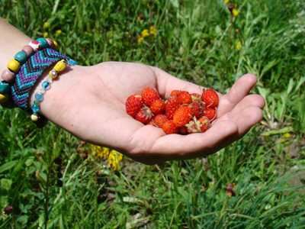
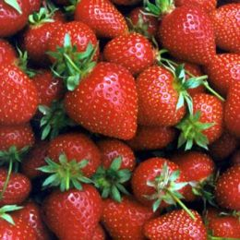
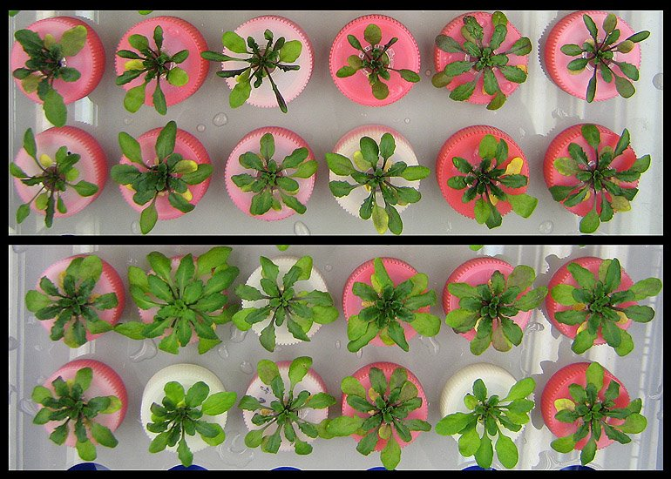
Having an extra set of chromosomes is fatal in animals, but in plants it makes them larger and hardier.
Hardier

Slide 50
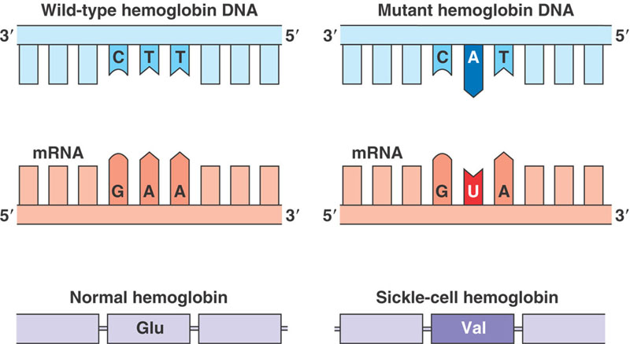
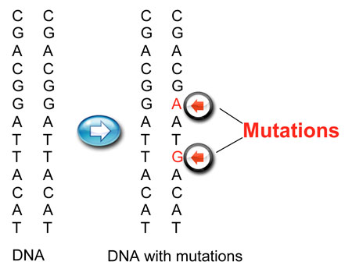
Gene or Point Mutation
most common and least drastic
only one gene is altered

Slide 51
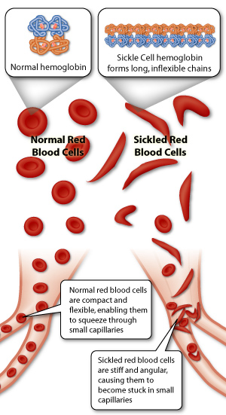
Examples:
Recessive gene mutations:
Sickle cell anemia – red blood cells are sickle shaped instead of round and cannot carry enough oxygen to the body tissues – heterozygous condition protects people from malaria

Slide 52
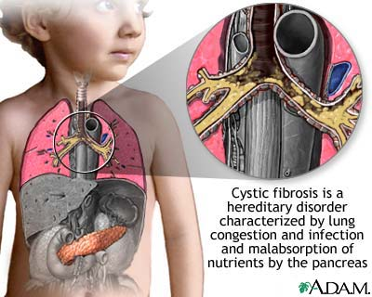
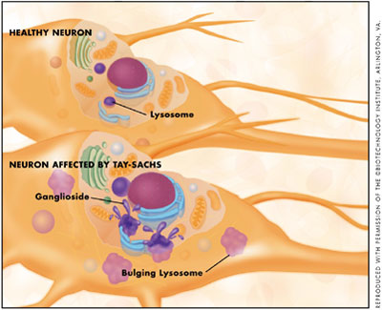
Cystic fibrosis – mucous builds up in the lungs
Tay-Sachs Disease – deterioration of the nervous system – early death
Mutated genes produce enzymes that are less effective than normal at breaking down fatty cell products known as gangliosides. As a result, gangliosides build up in the lysosomes and overload cells. Their buildup ultimately causes damage to nerve cells.

Slide 53
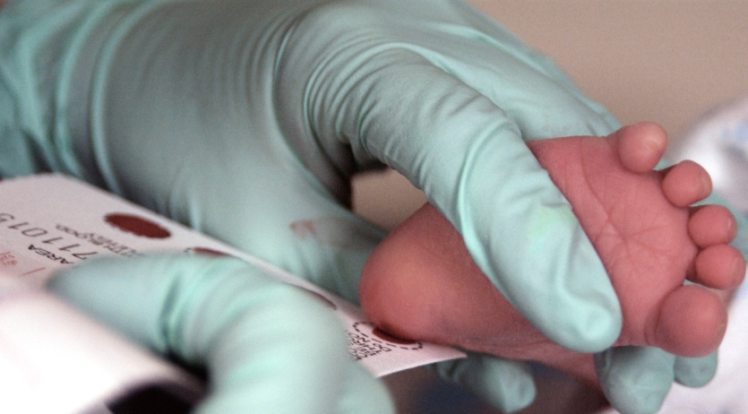
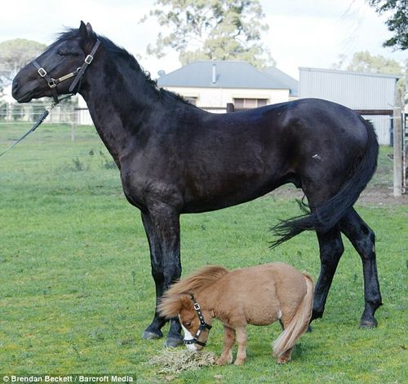


Phenylketonuria (PKU) – an amino acid common in milk cannot be broken down and as it builds up it causes mental retardation – newborns are tested for this
Dominant gene mutations:
Huntington’s disease – gradual deterioration of brain tissue, shows up in middle age and is fatal
Dwarfism – variety of skeletal abnormalities

Slide 54
Detecting Genetic Disorders
picture of an individual’s chromosomes – karyotype
amniotic fluid surrounding the embryo is removed for analysis – amniocentesis
Female with Down’s syndrome

Slide 55
18. Natural Selection
Leads to the predominance of certain traits in a population, and the suppression of others

Slide 56
19. Artificial Selection
Is the intentional reproduction of individuals in a population that have desirable traits.
Ex: Selective Breeding
  The practice by which humans select plants and animals for breeding based on desirable traits

Slide 57
20. Adaptation by Natural Selection
Traits that support successful survival and reproduction in the new environment become more common; those that do not, become less common

Slide 58

Pedigrees
Graphic representation of how a trait is passed from parents to offspring
Tips for making a pedigree
Circles are for females
Squares are for males
Horizontal lines connecting a male and a female represent a marriage
Vertical line and brackets connect parent to offspring
A shaded circle or square indicates a person has the trait
A circle or square NOT shaded represents an individual who does NOT have the trait
Partial shade indicates a carrier – someone who is heterozygous for the trait

Slide 59

Example: Make a pedigree chart for the following couple. Dana is color blind; her husband Jeff is not.
They have two boys and two girls.
HINT: Colorblindness is a recessive sex-linked trait.
X^{n}X^{n}
X^{N}Y
Has trait
Can pass trait to offspring

Slide 60

Multiple Alleles
3 or more alleles of the same gene that code for a single trait
In humans, blood type is determined by 3 alleles – A, B, and O
BUT each human can only inherit 2 alleles
Dominant – A and B (codominance)
Recessive – O
2. Blood type – A = AA or AO
B = BB or BO
AB = AB
O = OO

Slide 61
Example: What would be the possible blood types of children born to a female with type AB blood and
a male with type O blood?
AB X OO
A
B
O
AO | BO
AO | BO
O
Children would be type A or B only

