Slide 1
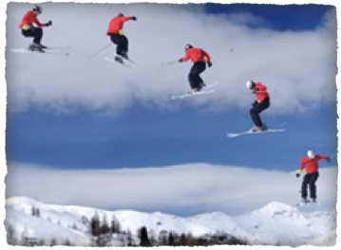
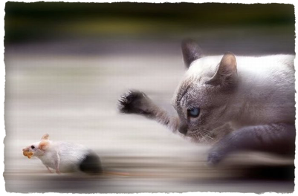
Notes on Motion
KJHS Science

Slide 2
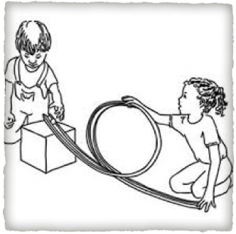
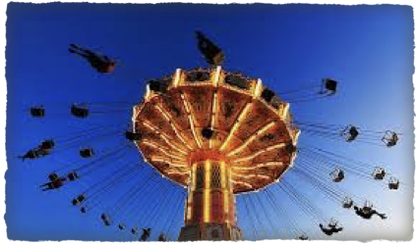
1)Motion:
an objects change in distance from another point
3 types of Motion: put a star next to these numbers on your vocab sheet
Speed (#3)*
Velocity (#6)*
Acceleration (#7)*

Slide 3
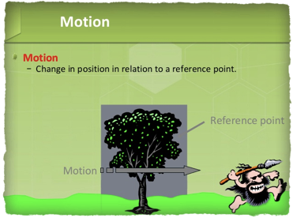
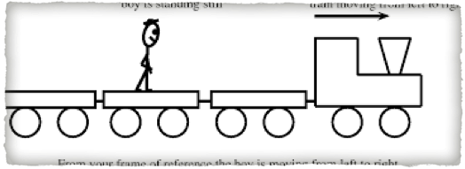
2)Reference Point
A stationary object used to compare a moving object to

Slide 4
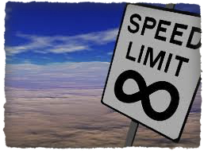
3) Speed
3) Speed
Formula=
distance time
the distance an object travels divided by the time takes to travel

Slide 5
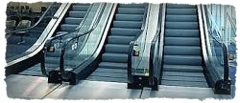
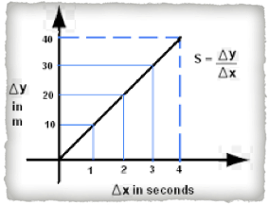
4)Constant Speed
moving at the same exact speed in a straight line
Also known as zero acceleration
speed graph
example:
escalator

Slide 6
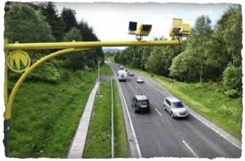
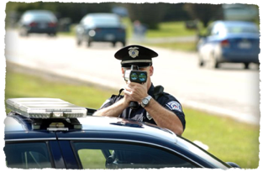
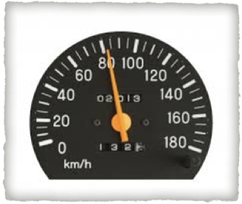
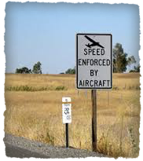
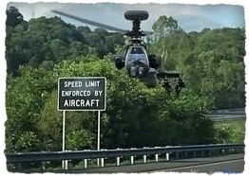
Instantaneous Speed
the speed that an object is moving in a specific instant

Slide 7
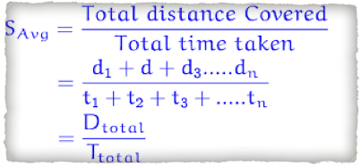
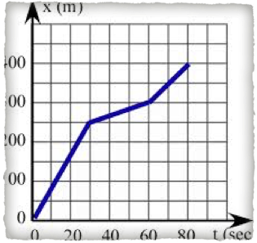
5) Average Speed
formula: Total distance total time
Add up all the distances, and then add up all the time(s), and then divide BOTH.

Slide 8
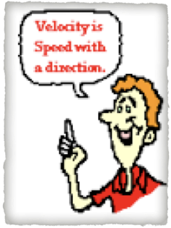
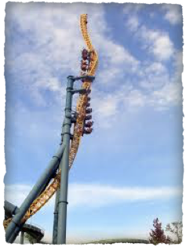
6) Velocity
Speed with a given direction
Example:
20m/s East

Slide 9
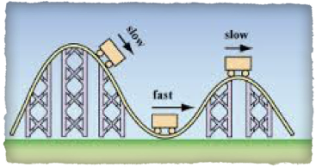
7) Acceleration
a change in velocity
it can change 3 ways:
increase speed
decrease speed
change direction at the same speed
units:
(m/s²)
or
(m/s/s)

Slide 10
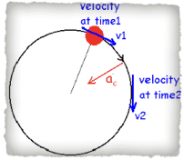
8) Momentum
MASS X VELOCITY
“bashing” power
units:
(kg)X(m/s)
or
(g)X(m/s)

Slide 11
Momentum is “conserved”, which means it is not lost (it transfers).
Ex: Newton’s Cradle
Momentum transfers from one object into the other object that it crashes into.

Slide 12
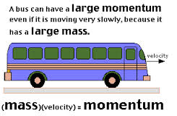
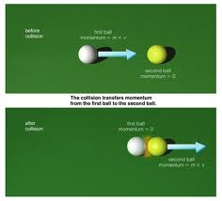
momentum bouncy balls

Slide 13
Momentum can be transferred, lost, or gained.
A snowboarder gets stuck on a flat part of the mountain.
An ice skater is spinning and tightens her spin and begins to spin faster
Hitting a cue ball into another pool ball.
A skateboarder going down hill
Lost
Gained
Transferred
Gained

Slide 14
All moving objects have momentum. (all moving things have velocity)
(0 velocity = 0 momentum)
When an object speeds up, it gains momentum – because velocity is increasing

Slide 15
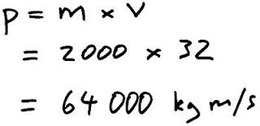
Calculate Momentum (MxV)
A 200 lb football player running 5 mph vs
A 300 lb football player running 2 mph
What would happen if they were running towards eachother? (who would knock down who)
1000 lb-mph
600 lb-mph
The 200 lb player would knock over the 300 lb player

Slide 16
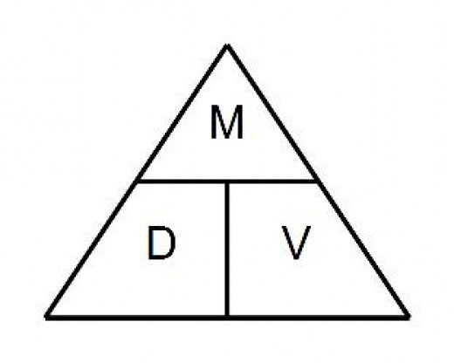
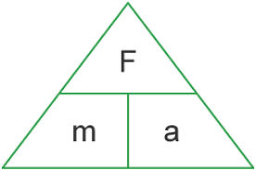
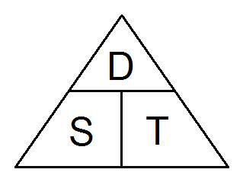

Slide 17
Energy…
is NEVER created or destroyed!
can only be STORED or TRANFERRED.

Slide 18
10. WORK: is done when an object is caused to move a certain distance.
11. ENERGY: the ability to do work or cause change.

Slide 19
12. Kinetic Energy (KE)
energy that is in motion
depends on two factors:
mass and speed.
Kinetic energy increases as mass increases, and also when speed increases.
KE = ½ X mass X speed²

Slide 20
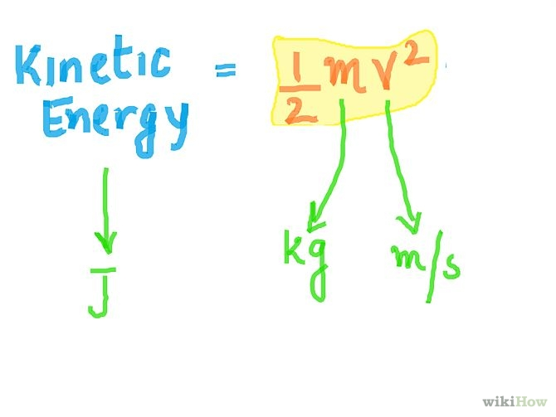
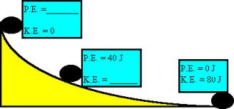
12) ADD TO KE #12 example: Unit= Joule (J)
Kinetic energy is measured in JOULES.
1 joule = 1 kg X (m/s)²

Slide 21
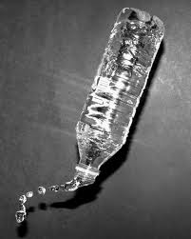
A water bottle is knocked off a desk. When does the bottle have the MOST kinetic energy?
A. At the top of the fall.
B. In the middle of the fall.
C. At the bottom of the fall.

Slide 22
C. At the bottom of the fall.
It has the most kinetic energy when its movement and speed are greatest, which is at the bottom of the fall right before it hits the ground.
When an object has the LEAST potential energy is when it has the MOST kinetic energy.
BrainPop

Slide 23
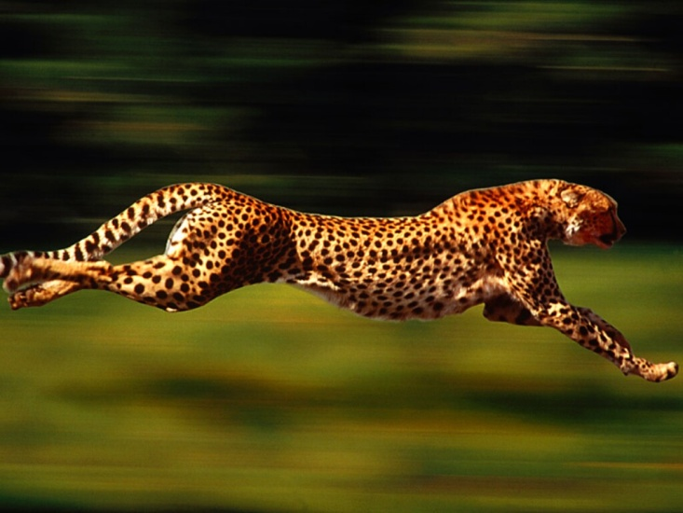
The faster the object moves, the more kinetic energy is produced.
The greater the mass and speed of an object, the more kinetic energy there will be.

Slide 24
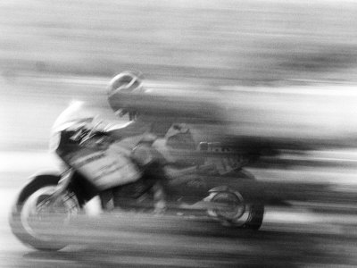
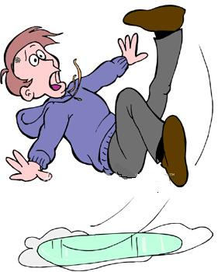
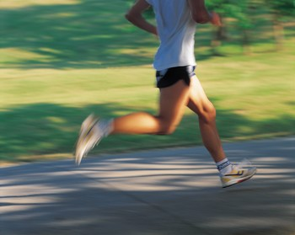
Examples of Kinetic Energy:

Slide 25
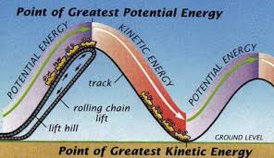
13. Potential Energy (PE)
stored energy that results from the position or shape of an object
GRAVITATIONIAL POTENTIAL ENERGY: depends on 2 factors of an object:
objects weight and its height.
PE= Weight X Height
Energy and a roller coaster

Slide 26
PE = (This information goes with #14)
PE= Weight X Height
PE= (mass) X ( gravitational pull) X (height)
The higher an object, the more PE (potential energy).
The more mass an object has, the more PE it has.

Slide 27
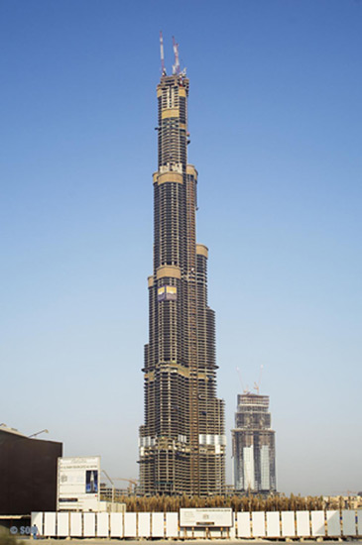
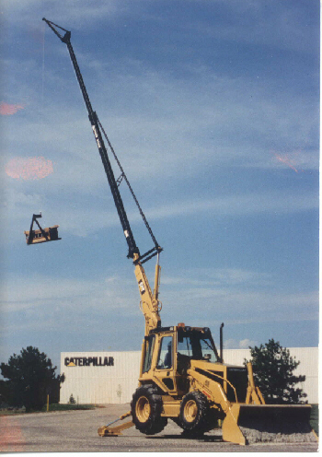
Changing an objects’ height can change its potential energy.
If I want to drop an apple from the top of one of these three things, where will be the most potential energy?
A
C
B

Slide 28
ANSWER
A
The higher the object, the more potential energy!

Slide 29
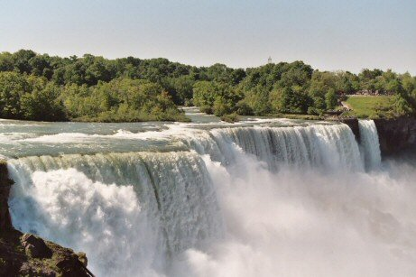
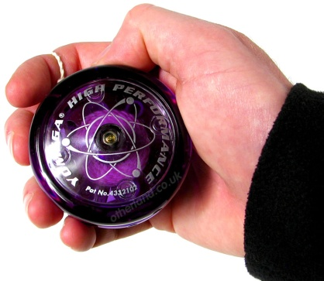
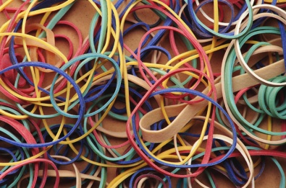
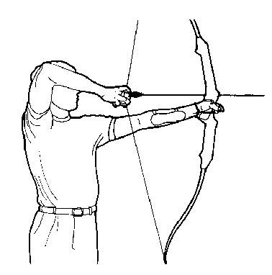
Examples of Potential Energy:
Water at the top of a waterfall..
Yo–Yo held in your hand..
A stretched rubber band..
A drawn Bow and Arrow…

Slide 30
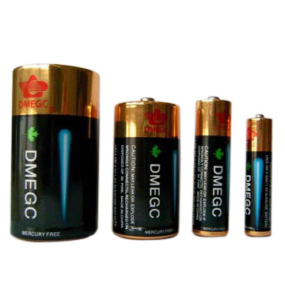
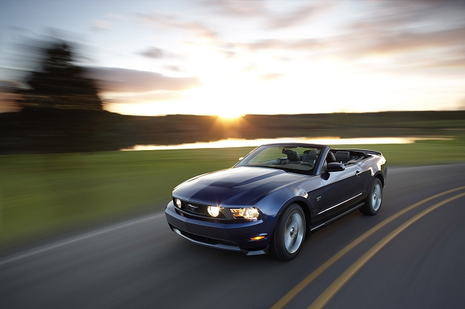
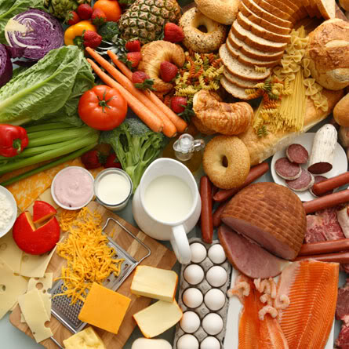
This car uses a lot of energy
Batteries store energy!
We get our energy from FOOD!
Even this sleeping puppy is using stored energy.

Slide 31
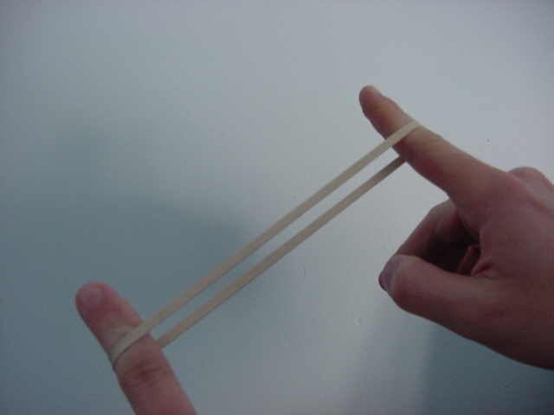
What is potential energy?
Potential energy due compression or expansion of an elastic object.
Notice the ball compressing
and expanding

Slide 32
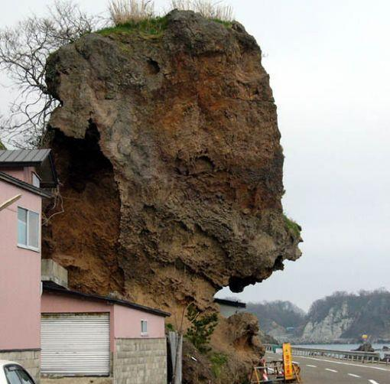
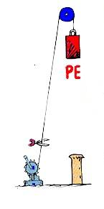
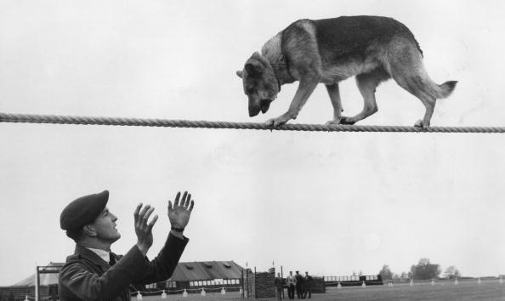
What is Gravitational Potential Energy?
Potential energy due to an object’s position
P.E. = mass x
height x gravity
Don’t look down, Rover!
Good boy!

Slide 33
14. How is all energy divided?
All Energy
Potential
Energy
Kinetic
Energy
Gravitation
Potential
Energy
Elastic
Potential
Energy
Chemical
Potential
Energy

Slide 34
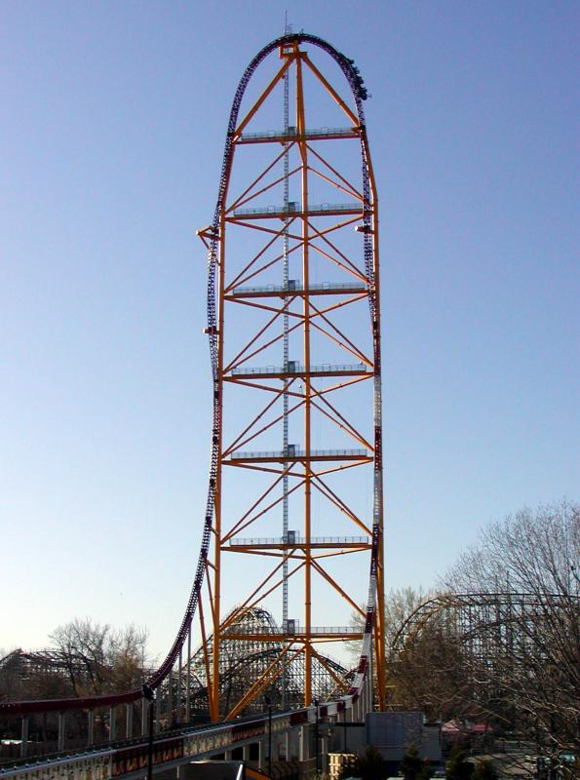
Roller Coasters
When does the train on this roller coaster have the MOST potential energy?
AT THE VERY TOP!
The HIGHER the train is lifted by the motor, the MORE potential energy is produced.
At the top of the hill the train has a huge amount of potential energy, but it has very little kinetic energy.

Slide 35
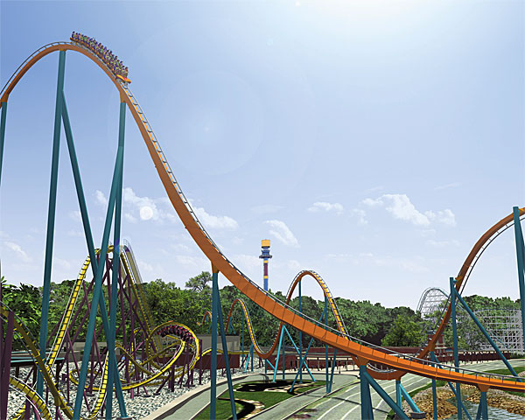
As the train accelerates down the hill the potential energy is converted into kinetic energy.
There is very little
potential energy at the bottom of the hill, but there is a great amount of kinetic energy.

Slide 36
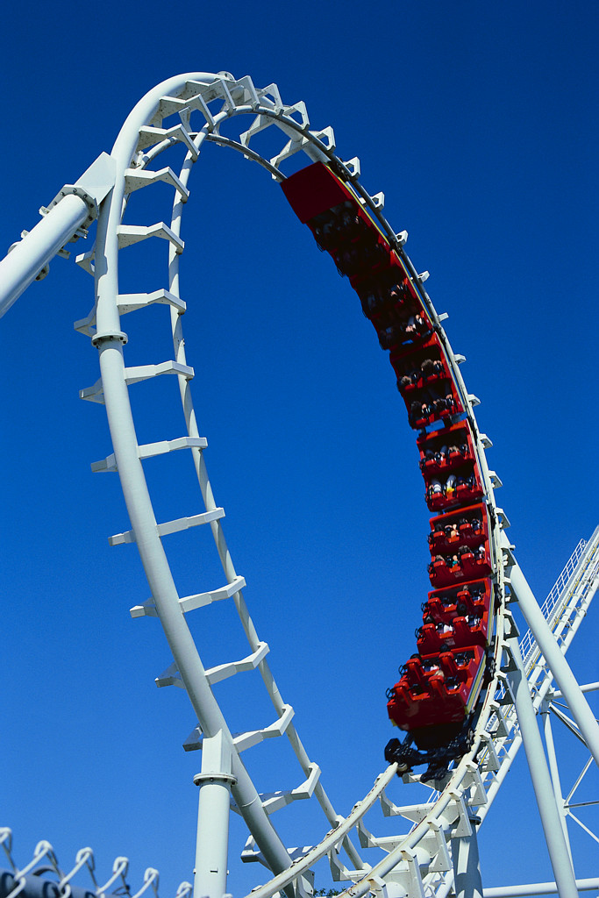
When does the train on this roller coaster have the MOST kinetic energy?
(When is it moving the fastest?)
(When does it have the LEAST potential energy???)
At the bottom of the tallest hill!

Slide 37
15) Balloon Car Forces
Air Resistance: The fluid friction experienced by objects falling through the air.
Drag: similar to air resistance – a force that is in the opposite direction of relative motion

Slide 38
#15 Continued
Rolling Friction: is the force resisting the motion when a body (such as a ball, tire, or wheel) rolls on a surface.
Newton’s 3rd Law: For every action or force, there is an equal and opposite reaction or force (known as the “action-reaction” law)

Slide 39
Momentum videos
http://www.youtube.com/watch?v=Jnj8mc04r9E&list=PL3E788EDA794CCE7B&index=6&feature=plpp_video
http://www.youtube.com/watch?v=BiLq5Gnpo8Q&list=PL3E788EDA794CCE7B&index=17&feature=plpp_video
http://www.youtube.com/watch?v=OuA-znVMY3I&list=PL3E788EDA794CCE7B&index=20&feature=plpp_video

