Slide 1
THE RECYCLING OF MATTER
Ms Toal

Slide 2
BIOCHEMICAL RECLYCLING
The Recycling of ecosystems is an important aspect of Earth’s systems.
The Earth has a fixed amount of chemical elements that can be used by organisms.
These elements form molecules, act as nutrients for organisms in ecosystemsm and are continually recycled (“BIOCHEMICAL RECYCLING”)
4 MAIN CYCLES: Carbon, Oxygen, Nitrogen, and Phosporus and a 5th: the water cycle

Slide 3
Carbon cycle

Slide 4
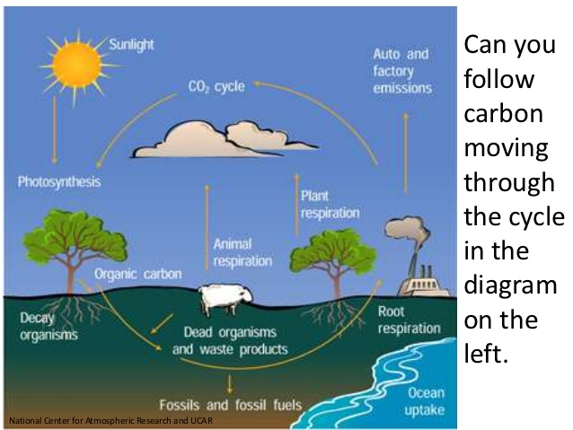

Slide 6
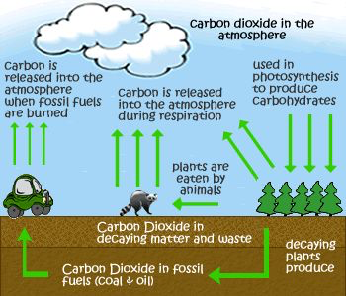

Slide 7
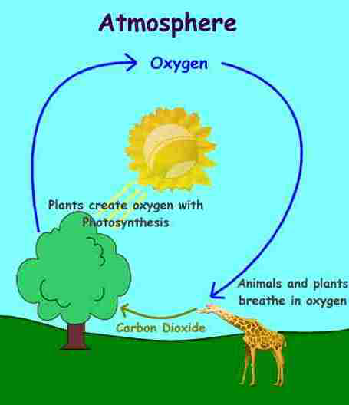
Oxygen cycle

Slide 8
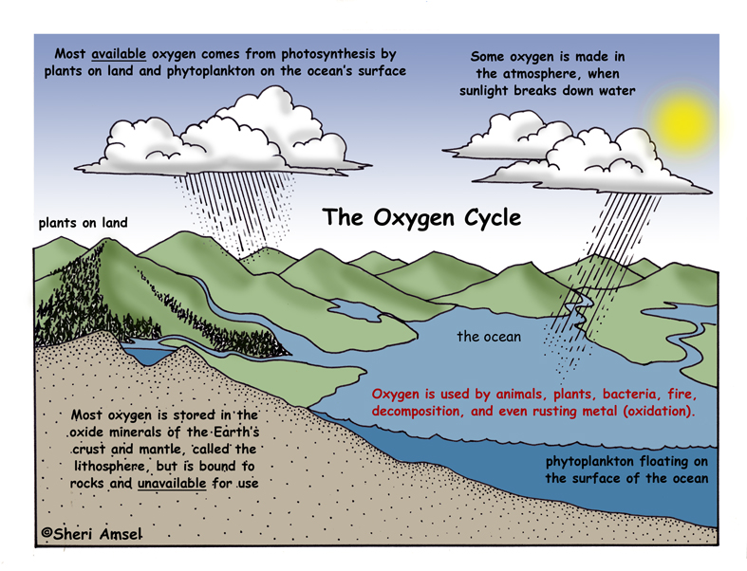

Slide 9
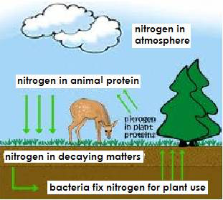

Slide 10
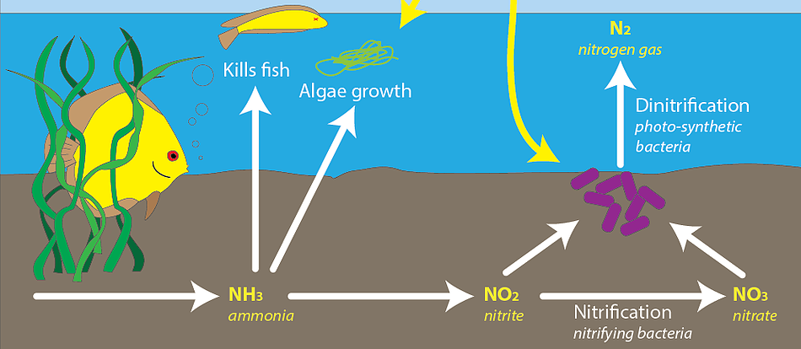
Nitrogen Cycle

Slide 11
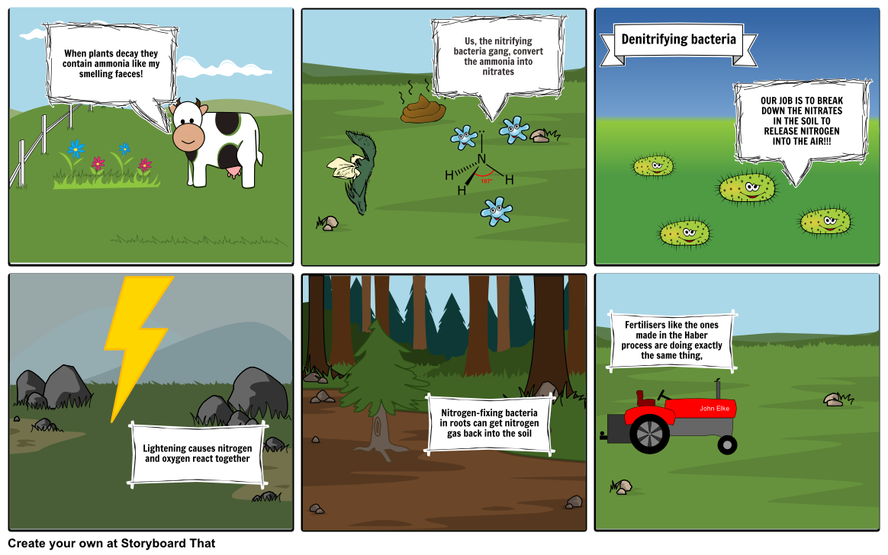
Nitrogen Cycle

Slide 12
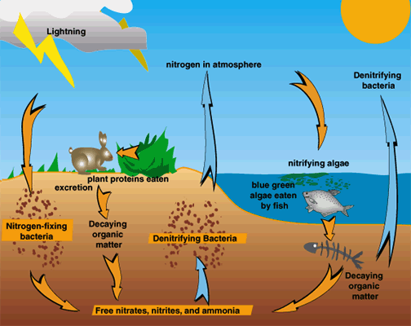
Nitrogen Cycle

Slide 13
Phosphorus Cycle

Slide 14
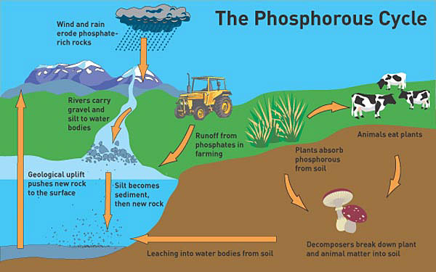
Phosphorus Cycle

Slide 15
Phosphorus Cycle Yes, that’s poop ☺

Slide 16
Water Cycle

Slide 17
Water Cycle

