Slide 1
Welcome Back to School 8th Science
Ms Toal

Slide 2
8th grade science
1st Trimester:
Intro/Refresh/Matter
Geology/Earth Science
Natural Selection
2nd Trimester:
Physics (Balloon Car project)
light
3rd Trimester:
Astronomy

Slide 3
8th grade science
MATTER UNIT: the metric system, mass, volume, density. Hands on labs.
PHYSICS: study of motion. Math based hands on labs and project based
Geology – extension of 7th , Geologic time scale, fossils, natural selection
balloon car project - Newton’s Laws.
WAVES/LIGHT: from slinky’s to EM spectrum.
ASTRONOMY: study of Earth, moon, sun and planets.

Slide 4
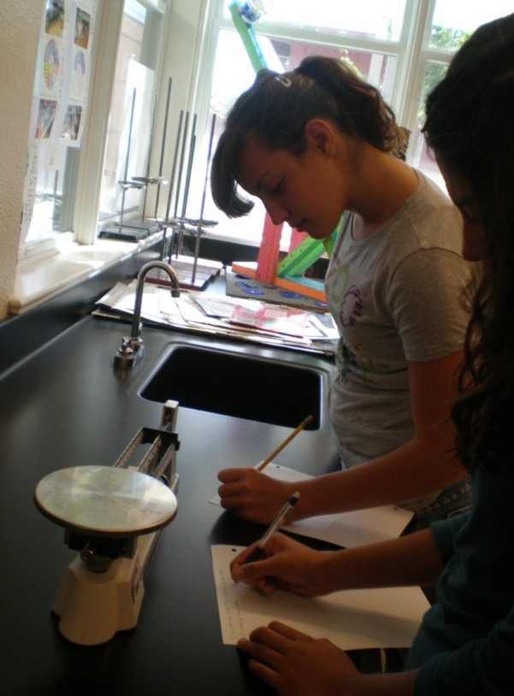
Matter Unit - measurements

Slide 5
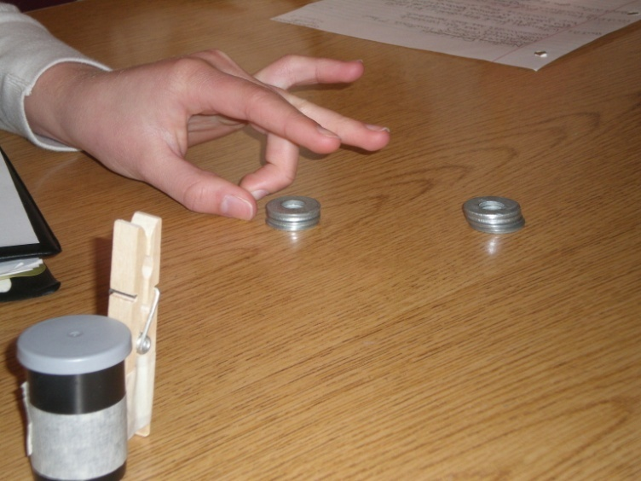
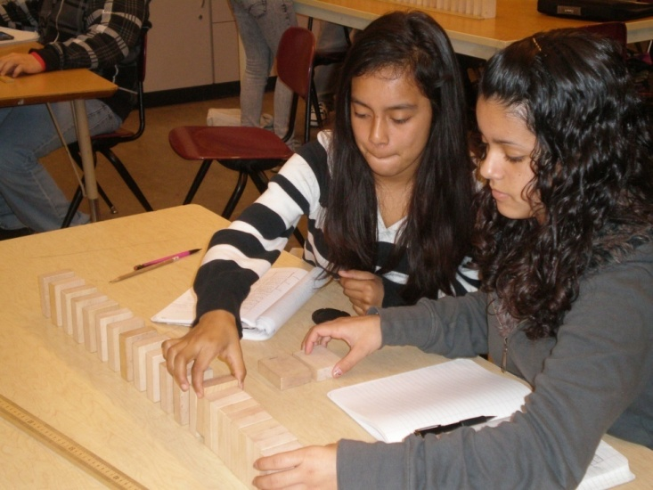
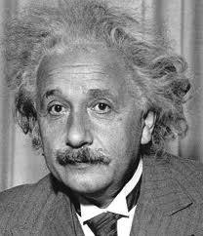
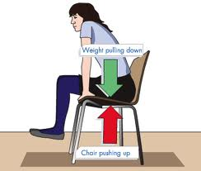
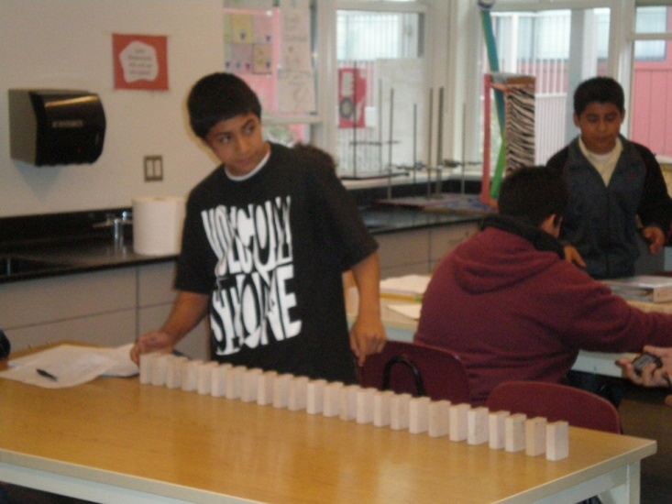
Physics unit

Slide 6
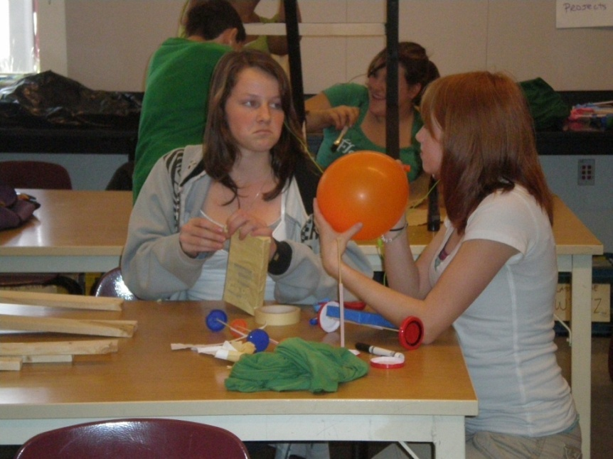
Physics – balloon cars

Slide 7
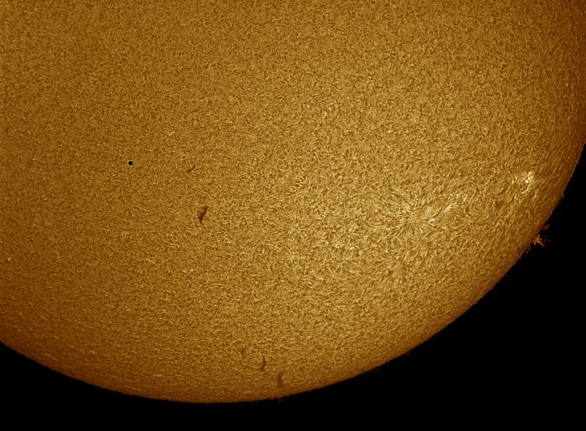
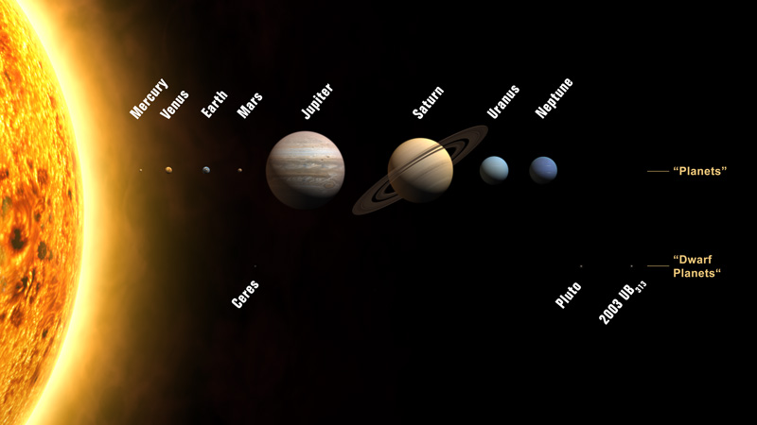
Astronomy – Earth moon sun

Slide 8
Grades
Check Schoology daily
Late homework won’t be accepted.
Late labs and late classwork will be marked down.
Please stay in touch via email – please give 1 day – 48 hours to respond.

Slide 9
Missed labs due to absences
There are no make up labs
If a lab is missed, you are still required to understand the concept from the lab.
You need to come see me about a missed lab. You will receive the lab sheet and will need to copy data from your table group.
AND…. you NEED to go to my website and Schoology to get caught up while you are resting at home.

Slide 10
How is science taught?
Lab book notes
text book reinforcement
Hands-on activities and labs
Traditional tests and quizzes (no retakes!)
Artwork – format, cut and measure
Chromebook research and design
Keep your lab book organized – donot throw or recycle any science work

Slide 11
Use your digital resources!
www.mstoal.com
Use it if your absent (daily agenda)
Use it if you aren’t sure of your homework (daily agenda; HW) or when an assignment is due
Use Schoology to check your grades and double check my comments after submitting assignments.

